Slide 1
A Brief Bibliometric Analysis of Information Science & Library Science Publications in 2018
Jan.17, 2019
Wei Chen and Chunying Wang

Slide 2
Method
The dataset of Information Science & Library Science subject contains 4214 research articles published in 2018 from the Web of Science database, retrieved by conducting the following query:
Then we used VOSviewer, Derwent Data Analyzer (DDA) to process, analyze and visualize the research topics, as well as the leading organizations and authors.
(1) Web of Science Core Collection
Science Citation Index Expanded (SCI-EXPANDED),
Social Sciences Citation Index (SSCI),
Conference Proceedings Citation Index- Science (CPCI-S)
(2) Subject category
Information Science & Library Science
(3) Timespan
2018 (Publication Year)
(4) Language
English
(5) Document types
Article, Letter, Proceedings Paper, Review

Slide 3
Interdisciplinarity
percentage of papers
Notes:
论文总数中前十位学科占比（不计IS&LS），具有跨学科研究性质

Slide 4
Keywords Cloud
Notes:
作者关键词词云

Slide 5
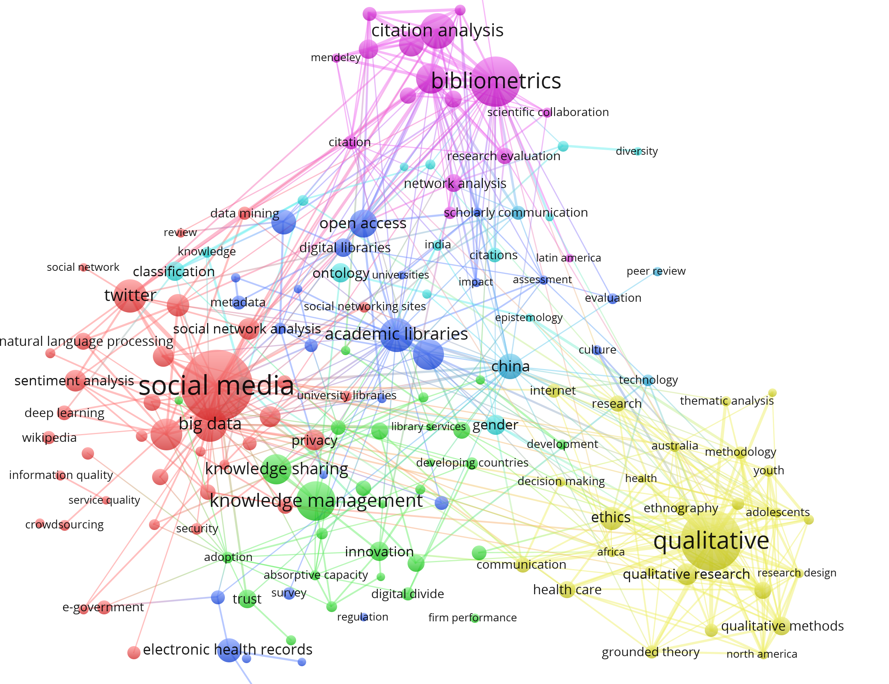
Co-occurrence Map of High-frequency Keywords
Notes:
高频关键词共现网络图

Slide 6
Cluster 1: Social Media Analysis
Research Topics:
Social network analysis
Sentiment analysis
Service quality analysis
Information behavior
Marketing, advertising
Social influence
Methods:
Text mining
Content analysis
Deep learning
Structural Equation Modeling
Altmetrics
Data Sources:
Twitter
Facebook
Notes:
聚类1 社交媒体分析相关研究主题

Slide 7
Cluster 2: Big Data, Machine Learning
Research Topics:
Decision making
Business analytics
Text classification
Ethics, including privacy, trust, security
Social influence
Methods:
Text mining
Data mining
Deep learning
Natural language processing
Topic modelling
Data Sources:
Twitter
Wikipedia
Notes:
聚类2 大数据、机器学习相关研究主题

Slide 8
Cluster 3: Bibliometrics, Scientometrics, Altmetrics
Research Topics:
Research productivity evaluation
Scientific collaboration
Impact assessment
Knowledge diffusion
Methods:
Citation analysis
Network analysis
Machine learning
Data Sources:
Google scholar
Scopus
Web of Science
Notes:
聚类3 文献计量相关研究主题

Slide 9
Cluster 4: Knowledge Management
Research Topics:
Knowledge creation, Knowledge organization, Knowledge sharing, Knowledge transfer
Technology adoption, Absorptive capacity
Open innovation, Entrepreneurship
Organizational performance
Methods:
Literature review
Case study
Ontology
Notes:
聚类4 知识管理相关研究主题

Slide 10
Cluster 5: Academic Libraries, Information Literacy
Research Topics:
Digital libraries, Linked data, Metadata, Information management
Open access; Institutional repositories
Scholarly communication
Information literacy, including students education, information behavior, information retrieval
Library services assessment
Semantic web
Methods:
Data mining
Text mining
Survey
Content analysis
Notes:
聚类5 学术图书馆管理与服务相关研究主题

Slide 11
Cluster 6: Medical Informatics
Research Topics:
Clinical decision support
Patient safety
Health care
Health information technology
Usability evaluation
Methods:
Case study
Interviews
Focus groups
Grounded theory
Data sources:
Electronic health records, etc.
Notes:
聚类6 医学信息学相关研究主题

Slide 12
Top Cited Papers
 | Title | Journal | Author | Times cited
1 | Search engine marketing is not all gold: Insights from Twitter and SEOClerks | International Journal of Information Management | Aswani, Reema, Kar; Arpan Kumar, Ilavarasan; P. Vigneswara; et al | 15
2 | Social network analysis: Characteristics of online social networks after a disaster | International Journal of Information Management | Kim, Jooho; Hastak, Makarand | 15 ESI TOP 1% highly cited paper
3 | Examining branding co-creation in brand communities on social media: Applying the paradigm of Stimulus-Organism-Response | International Journal of Information Management | Kamboj, Shampy; Sarmah, Bijoylaxmi; Gupta, Shivam; et al | 13
4 | A Guide to Field Notes for Qualitative Research: Context and Conversation | Qualitative Health Research | Phillippi, Julia; Lauderdale, Jana | 13 ESI TOP 0.1% highly cited papers
5 | Digital transformation by SME entrepreneurs: A capability perspective | Information Systems Journal | Li, Liang; Su, Fang; Zhang, Wei; et al | 11
Notes:
被引最多的文章概况

Slide 13
Top Cited Papers (cont’d)
 | Title | Journal | Author | Times cited
6 | Social media analytics - Challenges in topic discovery, data collection, and data preparation | International Journal of Information Management | Stieglitz, Stefan; Mirbabaie, Milad; Ross, Bjorn; et al | 11
7 | Predicting the research output/growth of selected countries: application of Even GM (1,1) and NDGM models | Scientometrics | Javed, Saad Ahmed; Liu, Sifeng | 10 ESI TOP 1% highly cited paper
8 | The impact of Transformational and Authentic leadership on innovation in higher education: The contingent role of knowledge sharing | Telematics and Informatics | Elrehail, Hamzah; Emeagwali, Okechukwu Lawrence; Alsaad, Abdallah; et al | 9
9 | From data to value: A nine-factor framework for data-based value creation in information-intensive services | International Journal of Information Management | Lim, Chiehyeon; Kim, Ki-Hun; Kim, Min-Jun; et al | 8
10 | Big data technologies: An empirical investigation on their adoption, benefits and risks for companies | International Journal of Information Management | Raguseo, Elisabetta | 8
Notes:
被引最多的文章概况

Slide 14
Leading Organizations
Notes:
发文最多的研究机构排名

Slide 15
Leading Organizations - Collaboration
Notes:
发文前50位机构合作关系图

Slide 16
Leading Organizations - Research Topics
Topics
Academic libraries
Bibliometrics
Big data
Knowledge
management
Medical
informatics
Social media
Wuhan Univ
Indiana Univ
Harvard Univ
Drexel Univ
Univ Michigan
Univ Illinois
Univ N Carolina
Chinese Acad Sci
Univ Washington
Univ S Florida
Notes:
前十位机构研究主题侧重（聚类得出的主题）

Slide 17
Leading Authors
Papers | Name | Top Collaborators | Organization | Top keywords
23 | Thelwall, Mike | Mas-Bleda, Amalia [3]; Kousha, Kayvan [2] | Univ Wolverhampton [23] | Citation analysis [10]; Mendeley [6]
22 | Bornmann, Lutz | Haunschild, Robin [8]; Leydesdorff, Loet [5] | Max Planck Gesell [12] | Bibliometrics [8]; Altmetrics [3]
11 | Bu, Yi | Ding, Ying [7]; Huang, Yong [4] | Indiana Univ [11] | Scientometrics [4]; Bibliometrics [2]
11 | Ding, Ying | Bu, Yi [7]; Xu, Jian [3] | Indiana Univ [11] | Scientometrics [2]
9 | Haunschild, Robin | Bornmann, Lutz [8]; Hug, Sven E [2] | Max Planck Inst Solid State Res [9] | Bibliometrics [4]; Altmetrics [3]
8 | Jatowt, Adam | Jorge, Alipio Mario [3]; Campos, Ricardo [3] | Kyoto Univ [8] | Information extraction [3]; Citation recommendation [2]; Keyword extraction [2]
8 | Leydesdorff, Loet | Bornmann, Lutz [5]; Wagner, Caroline S [2] | Univ Amsterdam [7] | Diversity [2]; Bibliometrics [2]; Journal [2]
8 | Rousseau, Ronald | Hu, Xiaojun [3] | Katholieke Univ Leuven [8] | None
Notes:
发文最多的作者概况

Slide 18
Leading Authors (Cont’d)
Papers | Name | Top Collaborators | Organization | Top keywords
7 | Abdullah, Abrizah | Aspura, M K Yanti Idaya [2] | Univ Malaya [7] | scholarly communication [2]; information literacy [2]
7 | Bates, David W | Slight, Sarah P [3]; Sittig, Dean F [2]; Seger, Diane L [2] | Harvard Univ [7] | quality of care [3]; clinical decision support [3]; electronic health records [3]
7 | Hu, Jiankun | Yin, Xuefei [2]; Zhu, Yanming [2] | Univ New South Wales [7] | Fingerprint [2]
7 | Sittig, Dean F | Wright, Adam [3]; Aaron, Skye [3]; Singh, Hardeep [2]; McEvoy, Dustin [2]; Bates, David W [2] | Univ Texas Hlth Sci Ctr [7] | clinical decision support [3]; electronic health records [3]; patient safety [2]
7 | Wright, Adam | Aaron, Skye [5]; Sittig, Dean F [3]; McEvoy, Dustin [3]; Ai, Angela [3] | Harvard Univ [7] | clinical decision support [3]; electronic health records [2]; safety [2]; anomaly detection [2]; Usability [2]
7 | Yan, Erjia | Li, Kai [4] | Drexel Univ [7] | Citation impact [2]; Scientometrics [2]
Notes:
发文最多的作者概况

Slide 19
A Brief Bibliometric Analysis of Information Science & Library Science
A Brief Bibliometric Analysis of ASIST 2018
A
Jan.17, 2019

Slide 20
Cluster :1 Academic Norms and Ethics
Research Topics:
Plagiarism Prevention
Information Standards
Data Sharing
Ethical Obligations and Best Practices
Ethical and Sustainable Information Future
Methods:
Cultural Studies
Value-Analytic Approach
Empirical Test
Survey
Notes:
聚类1 学术规范与伦理

Slide 21
Cluster 2: Information Retrieval
Research Topics:
Video Search
Exploratory Search
Search Engine Bias
Algorithmic Bias
Search User Interfaces
Word-level language Identification
Methods:
Survey
User-centered Evaluation
Machine Learning
Notes:
聚类2 信息检索

Slide 22
Cluster 3: Health Informatics
Research Topics:
Credibility of Health Information
Health Data Accessibility
Mobile-Health Technology
Health Information Technology
Health Literacy
Health and Public Libraries
Methods:
Case Study
Interviews
Focus Groups
Grounded Theory
Notes:
聚类3 健康信息学

Slide 23
Cluster 4: Information Behavior
Research Topics:
Research subject:
New Immigrants
International Student
Art Historian
Social Scientists
School Librarians
research content:
Intra-individual Information Behavior
Information Seeking Behaviors
Cross-device Search
Information Practices
Information Encountering
Music Search Behavior
Methods:
Case study
Interviews
Context analysis
Notes:
聚类4 信息行为

Slide 24
Cluster 5: Social Media Analysis
Research Topics:
Twitter Hashtags
Information Quality
Health Issues in Twitter
Public Libraries and Twitter
Social Network Analysis
Formal Learning
Political Communication
Challenges for Social Media
Methods:
Data Analysis
Web-based study
Topic Modeling
Text Mining
Semantic Analysis
Social Network Analysis
Focus Group
Notes:
聚类5 社交媒体分析相关研究主题

Slide 25
Cluster6 : Interdisciplinary Cooperation and Research
Research Topics:
Interdisciplinary
Co-authorship
Online Friendship
Social Network
Transdisciplinary Information Systems
Data Representations,
Data Re-Use
Knowledge Diffusion
Methods:
Interviews
Dual Network Analysis
Machine Learning
Content Analysis
Notes:
聚类6 跨学科合作

Slide 26
Cluster 7: New Technologies
Research Topics:
Virtual Reality
Wearable Camera
Methods:
Practical insights
Grounded theory
Case study
Self-efficacy theory
Notes:
聚类7 新技术

Slide 27
Cluster 8: Misinformation
Research Topics:
Online News Criteria Dynamics
Media Literacy
Fake News Classification
Trust in Digital Information
Methods:
Experiment
Machine Learning
Notes:
聚类8 虚假信息

Slide 28
Cluster9: Children and Youth
Research Topics:
Smartphone Use
New Media
language Learning
Information Access
Information Resources
Methods:
Narrative Inquiry
Textual Analysis
Longitudinal Study
Notes:
聚类9 儿童与青少年

Slide 29
Cluster 10: Digital Humanities
Research Topics:
Cultural Heritage Databases
Social Tagging
Arts and Humanities Collections
User Evaluation
Data Curation and Migration
Methods:
Interdisciplinary Method
Survey
Simple Random Sample
Data-Driven Analysis
Multi-case Study
Notes:
聚类10 数字人文

Slide 30
Cluster 11: Topic Modeling and Text mining
Research Topics:
Computational Social Science
Text Data Mining
Topic Modeling
Corpus Reproducibility
Methods:
Survey
Network Analysis
Semi-structured Interview
Notes:
聚类11 主题建模与文本挖掘

Slide 31
Cluster 12: Citation Analysis
Research Topics:
Citation distribution pattern
Citation Pattern
Citation dynamics
Citations and Features of Library Holdings
Characteristics of In-Text Citations
Article Length and Scholarly Impact
Methods:
Informatics analysis
pilot study
Correlation analysis
Natural language processing
Notes:
聚类12 引文分析

Slide 32
A Brief Bibliometric Analysis of Information Science & Library Science
A Brief Bibliometric Analysis of iConference 2018
A
Jan.17, 2019

Slide 33
Cluster 1: Social Media Analysis
Research Topics:
Social Content Management
Public Health
Social Media and Depression
Digital Scholar
Sentiment Analysis
Social Influence
Methods:
Interview Method
Case Study
Mixed-Method
Text Mining
Topic Modeling
Sampling Method
Notes:
聚类1 社交媒体分析相关研究主题

Slide 34
Cluster 2: Communication Studies and Online Communities
Research Topics:
Behavior and Network Position
Data-driven Journalism
Digital Village
Information Sharing
Digital Divide
Online Health
Methods:
Survey
Interviews
Focus Groups
Upward Spiral Model
Sentiment Analysis
Notes:
聚类2 交流研究与在线交流

Slide 35
Cluster 3: Mobile Information and Cloud Computing
Research Topics:
Information Policy
Data Reuse
Open Data
Cloud Service
Linked Data
Digital Library
Digital Nomads
Privacy
Methods:
Case Study
Content Analysis
Interviews
Notes:
聚类3 移动信息与云计算

Slide 36
Cluster 4: Data Mining and Data Analytics
Research Topics:
Data Mining
Text Retrieval
Knowledge Management
Data Curriculum
Data Visualization
Open Data
Methods:
Interview
Systematic Review
Literature Mining
Notes:
聚类4 数据挖掘与分析

Slide 37
Cluster 5: Information Retrieval
Research Topics:
Metadata
Information Need Categorization
Recommender Systems
Position Bias
Social Tag
News Event Detection
Systematic Review
Online Streaming Services
Citation Sentence Identification
Word Embedding
Influence of Algorithm
Clinical Decision Support
Semantic Measurement
Methods:
Web Logs Analysis
Query Analysis
Hierarchy Generation Algorithm
Semi-Structured Interviews
Thematic Analysis
Quantitative Analysis
Word Embedding
Co-word Analysis
Deep Learning
Notes:
聚类5 信息检索

Slide 38
Cluster 6: Information Behavior and Digital Literacy
Research Topics:
Emoji Usage
Information Seeking
Data Literacy
Political Information Network
Information Encountering
Search Behavior
Information Avoidance
Health Literacy
Participatory Design
Information Systems Implementation
Cross-device Search
Pedestrian Navigation
Methods:
Interview
Social Network Analysis
Survey
Diary Study
Experiment
Bonded Design Approach
Grounded Theory
Notes:
聚类6 信息行为和数字素养

Slide 39
Cluster 7: Digital Curation
Research Topics:
Metadata
Semantic Web
Data Management
Semantic Mediation
Digital Collections
Data Platform
Copyright
Methods:
Interview
Case Study
Ontology
Data analysis
Systematic review
Content analysis
Notes:
聚类7 数字管护

Slide 40
Cluster 8: Information Education and Libraries
Research Topics:
iSchools Heading
Digital 3D Technologies
Digital Humanities
Decision-making
Library Space
Information Intermediaries
Third Spaces
Library Services
Methods:
Investigation
Focus Group
Interview
Boundary Theory
Notes:
聚类8 信息教育和图书馆

Slide 41
Comparison of topics between 2018 and 2019
iConference 2018
Social Media Analysis
Communication Studies and
Online Communities
Mobile Information and Cloud Computing
Data Mining and Data Analytics
Information Retrieval
Information Behavior and Digital Literacy
Digital Curation
Information Education and Libraries
iConference 2019
Information Privacy
Data Equity
Forced Migration Research in LIS
Digital Inclusion
Fake News
Information Community
Research Community
Information Technology
Detecting and Taming Social
Troubleshooting Data

Slide 42
Thanks! Q&A Thanks to Mr. Wei Chen and Ms. Chunying Wang for making this PPT in three days!

