Slide 1
Research on Metadata in Digital Repositories
Dr. Oksana L. Zavalina,
Information Science Research Brown Bag presentation
November 10, 2021

Slide 2
Outline
Introduction to metadata in digital repositories: quality, change, etc.
UNT research team and publications on metadata change
2018-2020 IMLS-funded project & resulting publications
LangArc international workshops
TEL journal special issue on digital language archives
Future steps, Questions and Answers

Slide 3
Metadata is Essential for Providing Access to Information (and Data)
Without it:
humans would not be able to effectively find, identify, select and obtain information and data they need in everyday life, professional and scholarly activities, etc. ; explore relations between information/data objects
machines would not be able to assist humans in information/data seeking or to make inferences and connect pieces of information and data in a meaningful whole (e.g., Semantic Web)

Slide 4
Metadata: main components
Data content standards that guide creation of metadata records for various user communities
Data value standards that provide guidelines and controlled vocabularies for consistent representation of information in metadata elements and enable collocation and disambiguation of results.
Metadata records adequately representing important to users attributes of information objects (e.g., journal articles resulting from a research project) and data (e.g., datasets used in that research project):
e.g., audience; creator, contributor, publisher; date; format; title; type; topical, geographical and temporal subjects, and many more.
Metadata Schemes and Data encoding / transmission standards that enable structuring, sharing, exchanging and reusing metadata

Slide 5
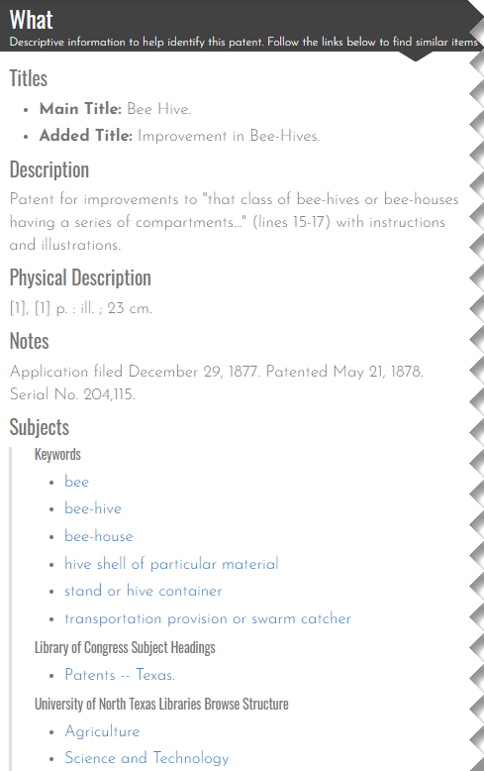
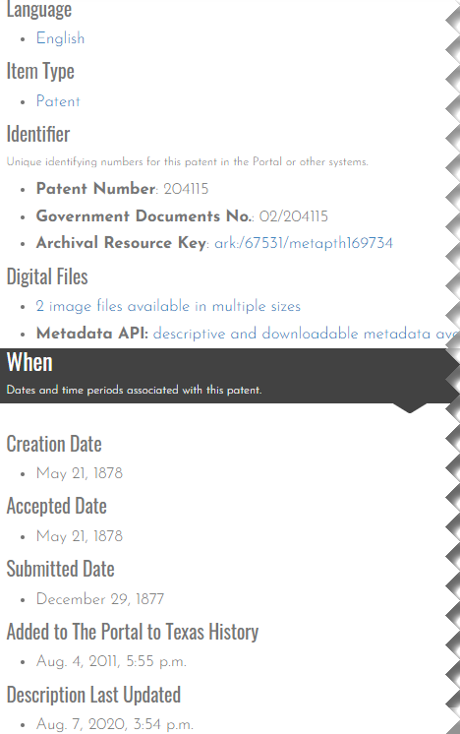
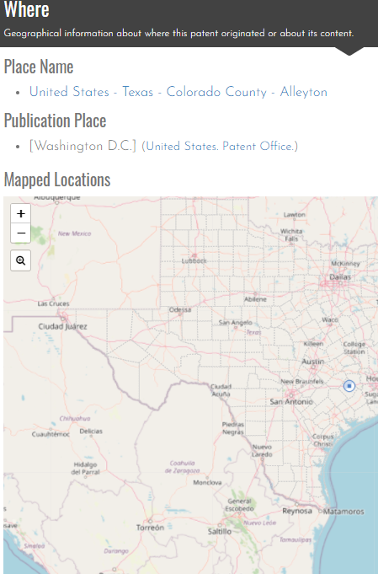
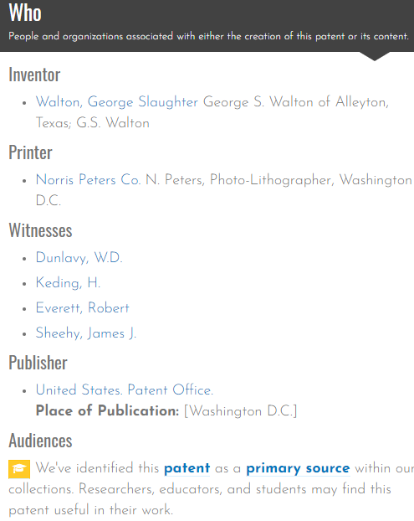
Metadata record example

Slide 6
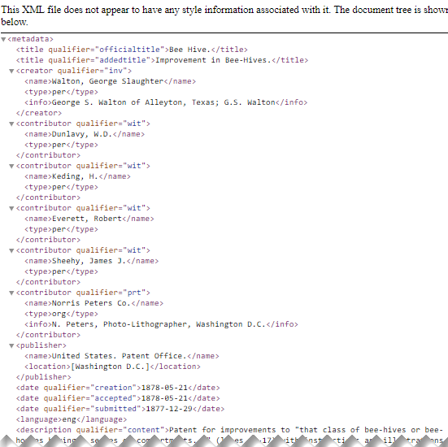
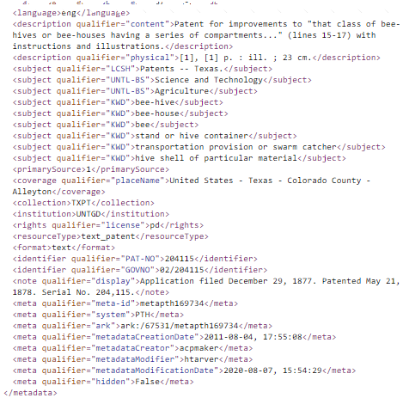
Same record example: another view

Slide 7
Digital Repository
A collection of online resources:
content is deposited (by the content creator, owner or third party)
offers a minimum set of basic services (put, get, search, access control)
is sustainable and trusted, well-supported and well-managed
the repository architecture manages content & metadata (Denison, 2007)
Two primary types of digital repositories:
institutional (collections of institution specific resources, e.g., UNT Scholarly Works)
subject/disciplinary (e.g., PubMed Central; arXiv; The Archive of the Indigenous Languages of Latin America)
© 2021 Dr. Oksana L. Zavalina

Slide 8
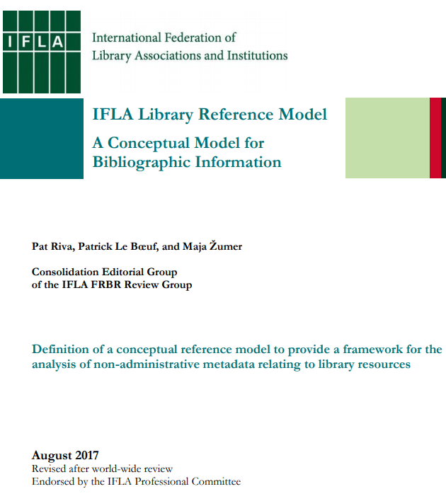
Quality of Metadata is Important
Metadata fitness for the purpose of enabling data/information discovery and reuse
through supporting user tasks:
© 2021 Dr. Oksana L. Zavalina
8

Slide 9
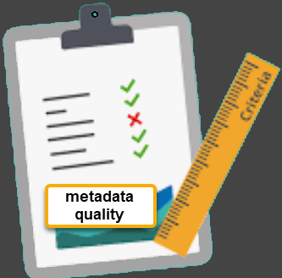
Metadata quality criteria suggested by the literature
Access
Accuracy
Availability
Compactness
Compatibility
Completeness
Comprehensiveness
Content
Consistency
Cost
Data Structure
Ease Of Creation
Ease Of Use
Economy
Flexibility
Fitness For Use
Informativeness
Protocols
Quantity
Reliability
Standard
Timeliness
Transfer
Usability
Most important
from the point of view of metadata creators
(e.g., Park & Tosaka, 2009)
© 2021 Dr. Oksana L. Zavalina

Slide 10
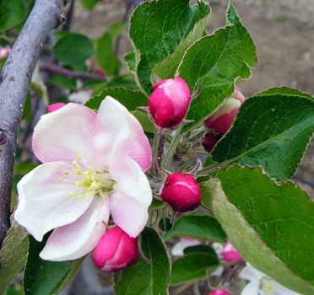
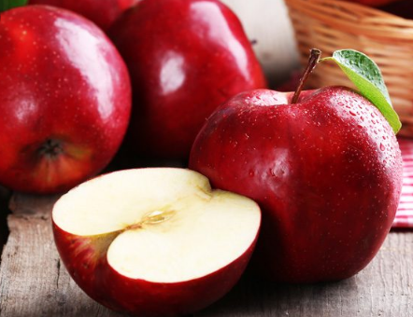
Evaluations of Metadata Quality in Repositories
Formative: in the process of designing, developing, prototyping
Summative: after implementation
Both serve to help decision makers in:
Determining if metadata creation and/or management should be
continued as is, OR
fundamentally or moderately revised (and specifically where and how)
Allocating resources
Planning for new or revised services
© 2021 Dr. Oksana L. Zavalina

Slide 11
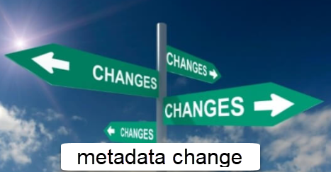
Metadata change
Change in metadata records is encouraged by agencies that facilitate cooperative metadata creation, management and sharing
To keep up with “environmental” changes, e.g.:
Growth in certain types/formats and subject matter of materials in repositories
Changes in the content & location of fluid materials (e.g., websites)
Goals of hosting & contributing institutions
KOS: classification systems & controlled vocabularies
National & international standards for metadata creation.
© 2021 Dr. Oksana L. Zavalina

Slide 12
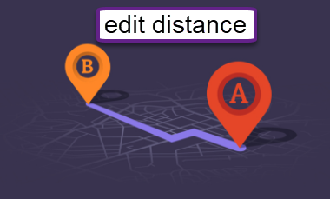
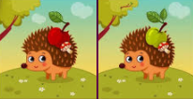
Change research in computer science: does NOT look into metadata
Mechanisms for identifying change (e.g., edit distance, Bille, 2005) and file comparison tools for isolating differences between:
files
texts, strings
programs, scripts, applications, ontologies
multiple versions of the same entities.
(e.g., Cheney, 2010; Horwitz, 1990; Noy et al., 2004)
© 2021 Dr. Oksana L. Zavalina

Slide 13
Change research in information science
BUT
Metadata quality research:
suggested the link between metadata change and metadata quality
emphasized the need to measure the metadata change and its outcomes for the users
(Stvilia et al., 2004;
Stvilia & Gasser, 2008)
Little published research identifying and measuring metadata change until recently
UNT team is pioneering metadata change research.
© 2021 Dr. Oksana L. Zavalina

Slide 14
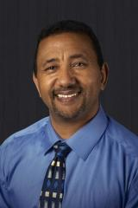
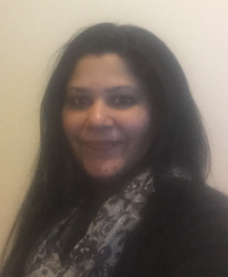
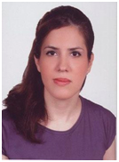
UNT researchers contributing to metadata change research since 2014
Dr. Daniel Alemneh
Dr. Priya Kizhakkethil
Dr. Mark Phillips
Dr. Shawne Miksa
Hannah Tarver
Dr. Shadi Shakeri
Dr. Slava Zavalin
Dr. Oksana Zavalina
Started contributing as students of IS PhD program
© 2021 Dr. Oksana L. Zavalina

Slide 15
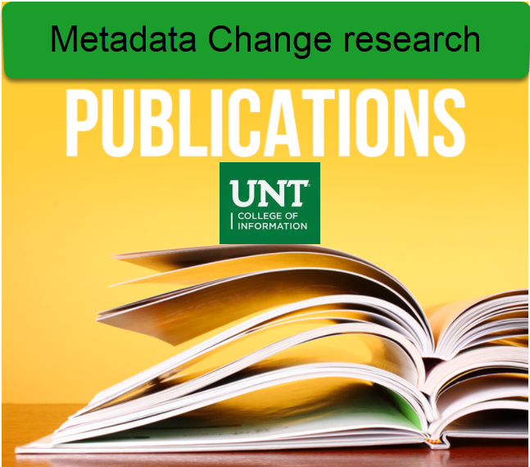
UNT researchers’ published contributions to metadata change research
Tarver, H. Zavalina, O.L., Phillips, M., Alemneh, D., & Shakeri, S. (2014). How descriptive metadata changes in the UNT Libraries’ Collections: a case study. Proceedings of the International Conference and Workshop on Dublin Core and Metadata Applications, Austin, Texas.
Zavalina, O.L., Kizhakkethil, P., Alemneh, D., Phillips, M., & Tarver, H.S. (2014). Metadata changes: meeting the evolving requirements. Proceedings of the 10th International Conference on Knowledge Management
Zavalina, O.L., & Kizhakkethil, P. (2015). Exploration of metadata change in a digital repository. Proceedings of the iConference 2015.
Zavalina, O.L., Kizhakkethil, P., Alemneh, D., Phillips, M., & Tarver, H.S. (2015). Building a framework of metadata change to support knowledge management. Journal of Information and Knowledge Management, 14 (1), 1-16.
Zavalina, O.L., Shakeri, S., & Kizhakkethil, P. (2015). Metadata change in traditional library collections and digital repositories: Exploratory comparative analysis. Proceedings of the Association for Information Science and Technology.
Zavalina, O.L., Shakeri, S., & Kizhakkethil, P. (2016). An empirical investigation of change in subject metadata in WorldCat. Proceedings of the International Federation of Library Associations World Library and Information Congress Satellite Conference "Subject Access: Unlimited Opportunities”.
© 2021 Dr. Oksana L. Zavalina

Slide 16
UNT researchers’ published contributions to metadata change research: continued
Zavalina, O.L., Zavalin, V., & Miksa, S. D. (2016). Quality over time: A longitudinal quantitative analysis of metadata change in RDA-based MARC Bibliographic Records Representing Video Resources. Proceedings of the Association for Information Science and Technology
Zavalina, O.L., Zavalin, V., Shakeri, S., & Kizhakkethil, P. (2016). Developing an empirically-based framework of metadata change and exploring relation between metadata change and metadata quality in MARC library metadata. Procedia Computer Science, 99, 50-63.
Zavalina, O.L., Phillips, M., & Tarver, H. (2017). Quality assurance and evaluation of change for patent metadata. Proceedings of the Association for Information Science and Technology.
Zavalina, O.L., Shakeri, S., Kizhakkethil, P., & Phillips, M.E. (2018). Uncovering hidden insights for information management: Examination and modelling of change in digital collection metadata. In Lecture Notes in Computer Science. New York: Springer.
Zavalina, O., L., & Zavalin, V. (2018). Evaluation of metadata change in authority data over time: An effect of a standard evolution. Proceedings of the Association for Information Science and Technology.
Zavalin, V., Zavalina. O.L., & Safa, R. (2021). Patterns of subject metadata change in MARC21 bibliographic records representing video recordings. Proceedings of the Association for Information Science and Technology
© 2021 Dr. Oksana L. Zavalina

Slide 17
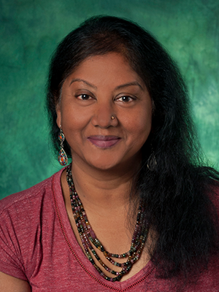
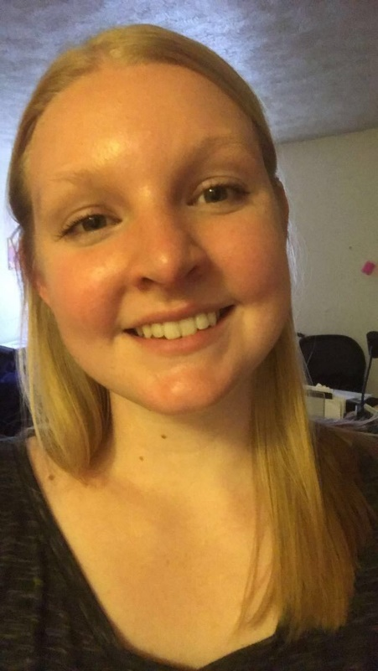
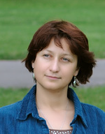
IMLS-funded project (2018-2020) researched information organization (including metadata) in digital language archives
Dr. Shobhana L. Chelliah (UNT Linguistics)
Dr. Mark E. Phillips
Mary Burke (UNT IS PhD student in Linguistics concentration program)
Dr. Oksana L. Zavalina

Slide 18
LG-87-18-0197 Exploring Methods and Techniques for Facilitating Access to Digital Language Archives
Project to identify the gaps between the information organization methods and techniques currently offered in existing language data archives and the needs of actual and potential language data archive users.
Provides necessary background information for project(s) aiming to extend the usefulness of existing language data archive collections through a user-centered design of systems incorporating the efficient methods and techniques for providing digital access to language data collections at scale.
© 2021 Dr. Oksana L. Zavalina

Slide 19
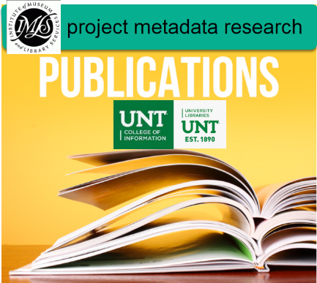
LG-87-18-0197 Publications: student first author
Burke, M., & Zavalina, O. L. (2019). Exploration of information organization in language archives. Proceedings of the Association for Information Science and Technology, 56(1), 364-367. https://doi.org/10.1002/pra2.30
Burke, M., & Zavalina, O.L. (2020). Descriptive richness of free-text metadata: a comparative analysis of three language archives. Proceedings of the Association for Information Science and Technology, 57(1), e429. https://doi.org/10.1002/pra2.429
Burke, M., & Zavalina, O.L. (2020). Identifying challenges for information organization in language archives. iConference 2020: Sustainable Digital Communities, pp.622-629. https://doi.org/10.1007/978-3-030-43687-2_52
Burke, M., Zavalina, O.L., Phillips, M., & Chelliah, C. (2021). Organization of knowledge and information in digital archives of language materials. Journal of Library Metadata, 21(2), 185-217. https://doi.org/10.1080/19386389.2020.1908651
Burke, M., Zavalina, O.L, Chelliah, S.L., & Phillips, M.E. (2021, in press). Language archive user needs: Findings from interviews with language archive managers, depositors, and end-users. Language Documentation and Conservation.
© 2021 Dr. Oksana L. Zavalina

Slide 20
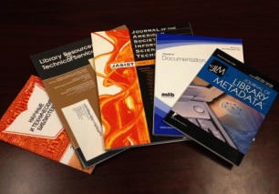
Metadata-related research is published in:
journals, e.g.:
Journal of Library Metadata | https://www.tandfonline.com/toc/wjlm20/current
Cataloging and Classification Quarterly | https://www.tandfonline.com/toc/wccq20/current
The Electronic Library journal | https://www.emerald.com/insight/publication/issn/0264-0473
International Journal of Metadata, Semantics, and Ontologies | https://www.inderscience.com/jhome.php?jcode=ijmso
Journal on Information and Knowledge Management | https://www.worldscientific.com/worldscinet/jikm
Library Resources and Technical Services | https://www.ala.org/alcts/resources/lrts
Journal of the Association for Information Science and Technology (JASIS&T) | https://asistdl.onlinelibrary.wiley.com/journal/23301643
20
© 2021 Dr. Oksana L. Zavalina

Slide 21
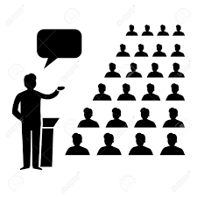
Metadata-related research is published in:
conference proceedings, e.g.:
Dublin Core Metadata Initiative (DCMI) annual conference | https://dublincore.org/conferences/
International Conference on Knowledge Management: CFP open until Nov. 30, 2021 | http://www.ickm.net/
ACM/IEEE Joint Conference on Digital Libraries (JCDL) Also, its European equivalent (ECDL or TPDL), Asian equivalent (ICADL) | https://www.jcdl.org/ http://www.tpdl.eu/ https://link.springer.com/conference/icadl
iSchools annual conference (iConference) | https://ischools.org/iConference
ASIS&T annual meeting | https://www.visitpittsburgh.com/2022-asis-t-annual-meeting/
21
© 2021 Dr. Oksana L. Zavalina

Slide 22
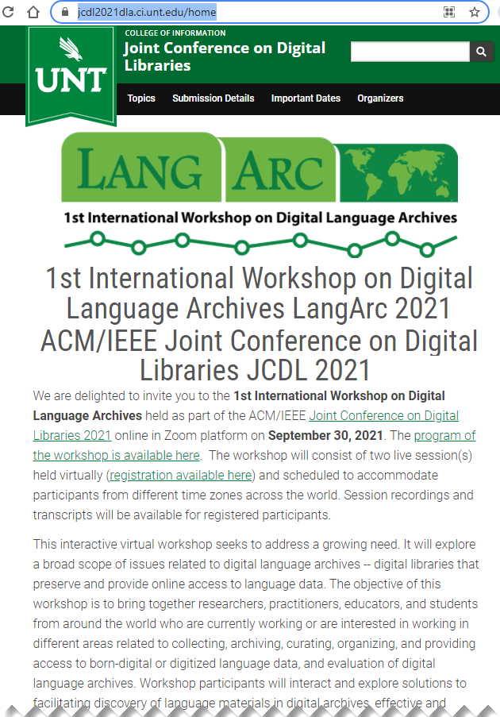
LangArc international workshop
Covers a variety of topics related to a special kind of digital repository: a digital language archive
1st workshop organized as part of JCDL 2021 conference and hosted by UNT COI online 09/30/2021
Intended to continue annually
Publishes proceedings, with accepted brief papers (~1500 words)
© 2021 Dr. Oksana L. Zavalina

Slide 23
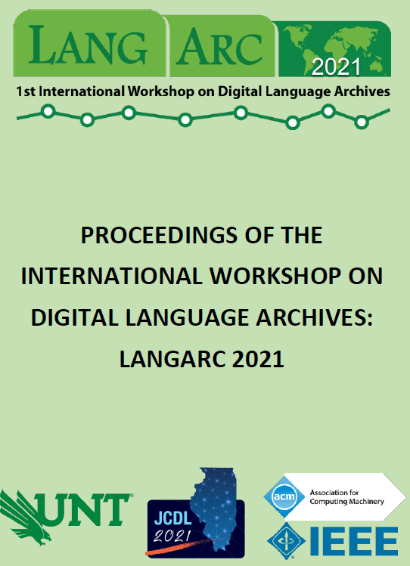
LangArc 2021 proceedings
Open access in 2 digital repositories:
UNT Digital Library: https://digital.library.unt.edu/explore/collections/LANGARC/
IDEALS:
https://www.ideals.illinois.edu/handle/2142/110998
© 2021 Dr. Oksana L. Zavalina

Slide 24
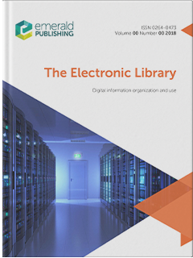
The Electronic Library journal special issue on digital language archives (DLA)
https://www.emeraldgrouppublishing.com/calls-for-papers/digital-language-archives
Submissions accepted until January 15, 2022
Some possible topics include:
societal/political/legislative/economic factors affecting DLA;
administrative structures and partnerships of DLA;
collection development in DLA;
information architecture, organization (including metadata), and retrieval in DLA;
quality assurance in DLA;
usability and user experiences in DLA;
theory and history of DLA;
evaluations (case studies and comparative analyses) of DLA
education initiatives to support DLA development
© 2021 Dr. Oksana L. Zavalina

Slide 25
interested in metadata research?
Please send me an email and/or set up a meeting with me.
I will be happy to address ANY of your questions about:
Research problems/questions
Collecting new or using existing data
Ways of analyzing data
etc.
Oksana.Zavalina@unt.edu
© 2021 Dr. Oksana L. Zavalina

Slide 26
interested in metadata research but lack metadata background?
No problem! Complete these UNT graduate courses:
INFO 5223 Metadata 1
INFO 5210 Cataloging & Classification 1
INFO 5740 Digital Libraries
Also, might benefit from:
INFO 5224 Metadata 2
INFO 5220 Cataloging & Classification 2
INFO 5212 Dewey Decimal Classification
etc.
© 2021 Dr. Oksana L. Zavalina

Slide 27
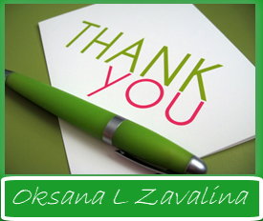
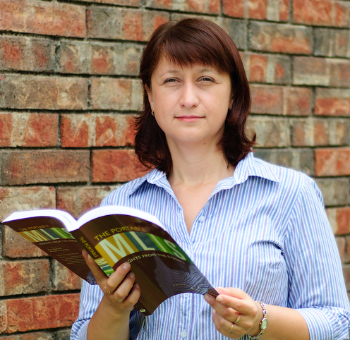
Questions
&
Answers
© 2021 Dr. Oksana L. Zavalina

