Slide 1
Brown bag at College of Information, University of North Texas
INFORMATION BEHAVIOR LANDSCAPE
Liuxing Lu, Yu Shi
School of Information Management | Wuhan University
February 5, 2020

Slide 2
01
About us
Overview for information behavior research
02

Slide 3
01
About us
A brief self-introduction

Slide 4
Yu Shi
A PhD student from Wuhan University, China (Supervisor: Dr. Ziming Zeng)
A visiting scholar at UNT (Supervisor: Dr. Junhua Ding)
Major: Management Science and Engineering
Research interest: information behavior, information recommendation
(1) Information recommendation based on user cognition (2) User interest modeling.

Slide 5
Dr. Ziming Zeng
A professor at the School of Information Management
Research interests: recommender system, data mining, mobile visual search
Published 5 books and over 100 papers on academic journals

Slide 6
Liuxing Lu
A PhD student from Wuhan University, China (Supervisor: Dr. Dan Wu)
A visiting scholar at UNT (Supervisor: Dr. Jiangping Chen)
Major: Library Science
Research interest: information behavior, information retrieval
(1) Query reformulation in cross-device search. (2) Emotions change in pedestrian navigation while using map APP. (3) Factors that influence users’ mobile reading efficiency etc.

Slide 7
Dr. Dan Wu
A professor at the School of Information Management, Wuhan University
A Fulbright Scholar of University of North Carolina at Chapel Hill (2018)
Secretary, ASIS&T Asia-Pacific Chapter
General chair of the ACM/IEEE Joint Conference on Digital Libraries (JCDL) 2020
Research interests: information retrieval, information behavior, human-computer interaction, multilingual information processing and information organization
Published 7 books and over 150 papers on academic journals

Slide 8
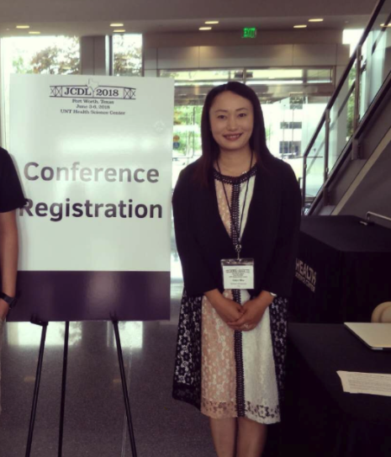

Slide 9
Overview for information behavior research
02
Hotspots, trends, theories, and methods

Slide 10
Information behavior
The totality of human behavior in relation to sources and channels of information, including both active and passive information seeking, and information use.
(Wilson, 2000)
The term used to describe the many ways in which human beings interact with information, in particular, the ways in which people seek and utilize information.
Focusing on “the human relationship to information”.
(Bates, 2010)
The totality of all the activities that take place while searching, seeking, encountering, retrieving, processing, integrating, and using information.
(Spink and Cole, 2004)

Slide 11
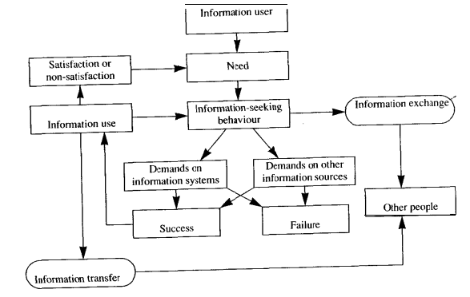
Information behavior
Wilson’s model of information behavior (1981)

Slide 12
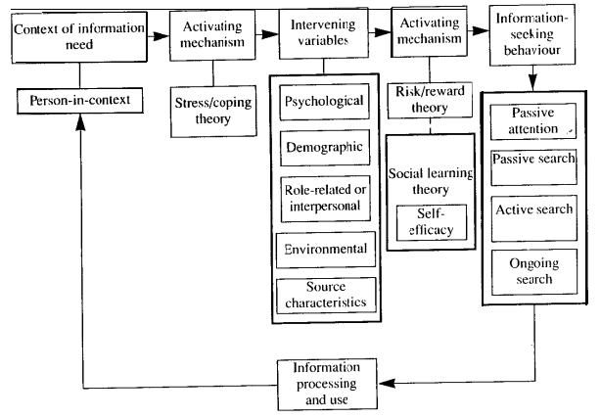
Information behavior
Wilson’s 1996 model of information behavior

Slide 13
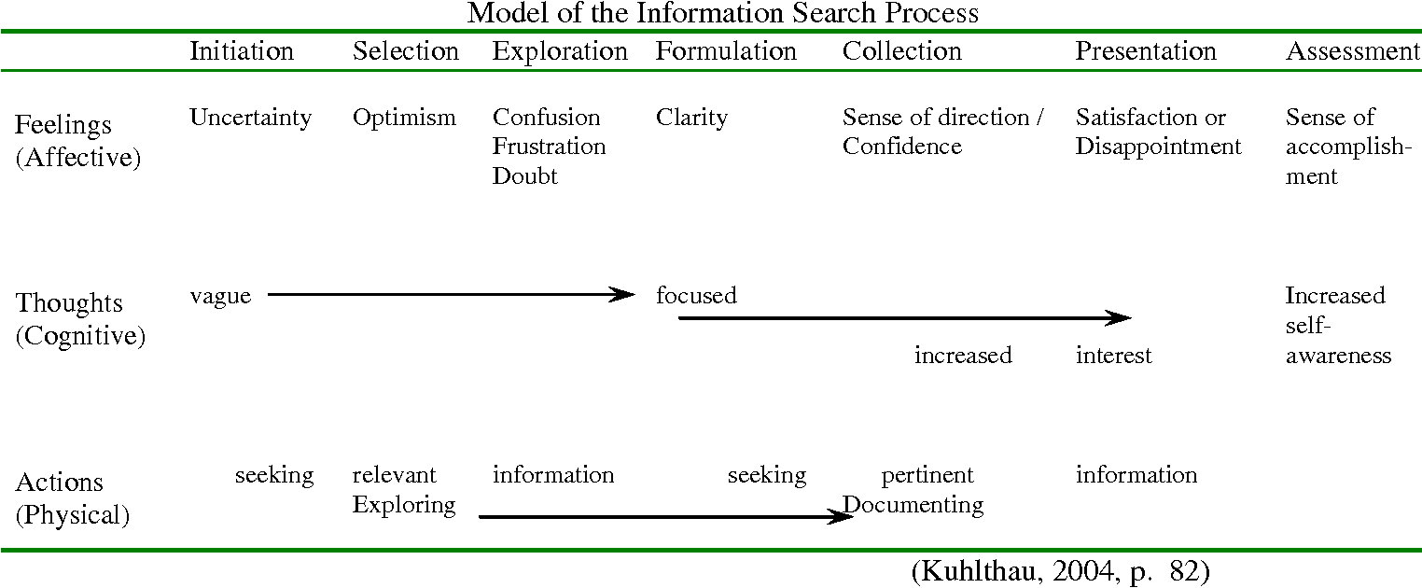
Information behavior

Slide 14
Information behavior
The term to describe individuals interact with (e.g. need, seek, give, and use ) information in different contexts (e.g. everyday living, schools, workplace).
Involved people’s cognitive, physical, and affective factors.
(LIS) information interaction between users and systems (e.g. users find & use info, systems provide services based on users’ behavior)

Slide 15
Hotspots & research trends
children, senior, college students, librarians, immigration, doctors, engineers, homeless people, LGBTQ, etc.
Information seeking behavior (ISB)
- mobile information seeking (multi-device search), collaborative information seeking, health information seeking on websites.
- the process and characteristics of ISB, the factors that influence ISB (devices, users’ emotions, tasks difficulties, etc.), information recommendation based on ISB
Living
Working
Learning
Contexts
…

Slide 16
Theories & models/frameworks
Library and information science
- Wilson’s models (Wilson, 1981; Wilson, 1996); Kuhlthau’s model of the Information Search Process (ISP) (Kuhlthau, 1988); Berry-picking principle (Bates, 1989); Information foraging theory (Savolainen, 2017); Sense-making theory (Savolainen, 2014; Zhang et al., 2008)
Psychology
- Social cognitive theory (SCT)/Social learning theory (Jean et al., 2018; Moring, 2016); Theory of selective exposure (Dali, 2018); Appraisal theories (Savolainen, 2014); Expectancy-value theory (Savolainen, 2012)

Slide 17
Theories & models/frameworks
Sociology
- Practice theory (Gorichanaz, 2018);
Others
- [Education] Bruner’s (1966) theory of instruction;
- [Journalism, media studies and communication] Critical and cultural theory (Ocepek, 2018)

Slide 18
Methods
Mix methods (qualitative + quantitative)
Data collection methods
- questionnaires, interviews
- user experiments, think-aloud, eye-tracking, log collection, information world mapping, screen recording
Data analysis methods
- statistic analysis (descriptive, regression, etc.)
- content analysis, text analysis

Slide 19
Hotspots & research trends
Information Sharing Behavior
Hotspots: Factors that influence information sharing behavior
User; environment; technology
User: motivation, personality traits (Liu et al., 2017; Kim et al., 2018);
Environment: information sharing environment (community environment) (Chiu et al., 2011);
Technology: information display (Nicoleta, 2017)

Slide 20
Hotspots & research trends
Information Sharing Behavior
Theories:
social cognitive theory (Bandura, 1991); social capital theory(Chang,2011); social exchange theory(Liang,2008); social identity theory(Chung,2012); motivate theory(Hung,2011); justice theory(Chiu,2011); trust(Salehan,2018)

Slide 21
Hotspots & research trends
Information Sharing Behavior
Method: qualitative + quantitative
questionnaire, semi-structured interviews, observations, think-aloud, document analysis, user experiment
Trends:
Relationship among various factors in information sharing behavior
Utilizing multi-method approach to analyze sharing behavior

Slide 22
Hotspots & research trends
The Application of Information Behavior in Recommendation
Recommendations are created by using the user behavior (e.g. creating user portrait)
User behavior can be collected implicitly and explicitly
User behavior: rating, the number of clicked item and the sequence of the clicked items in the recommendation list, the duration of tracking, likes and dislikes and remarks on items

Slide 23
Hotspots & research trends
The Application of Information Behavior in Recommendation
Method: experimental method, network log analysis
Trends:
Learning recommender systems from user multi-behavior data.
Identifying fine-grained interest of user.

Slide 24
References
Savolainen, R. (2017). Heuristics elements of information-seeking strategies and tactics: a conceptual analysis. Journal of Documentation.73(6), 1322–1342. http://dx.doi.org/10.1108/JD-11-2016-0144
Asla, T. M., & Williamson, K. (2015). Unexplored territory: information behaviour in the fourth age. Information Research, 20(1), 158–169. Retrieved from http://InformationR.net/ir/20- 1/isic2/isic32.html
Courtright, C. (2007). Context in information behavior research. Annual Review of Information Science and Technology, 41(1986), 273–306. https://doi.org/10.1002/aris.2007.1440410113
Dali, K. (2018). The lifeways we avoid: The role of information avoidance in discrimination against people with disabilities. Journal of Documentation, 74(6), 1258–1273. https://doi.org/10.1108/JD-04-2018-0057
Gorichanaz, T., Latham, K. F., & Wood, E. (2018). Lifeworld as “unit of analysis.”. Journal of Documentation, 74(4), 880–893. https://doi.org/10.1108/JD-12-2017-0174
Greyson, D., O’Brien, H., & Shoveller, J. (2017). Information world mapping: A participatory arts-based elicitation method for information behavior interviews. Library and Information Science Research, 39(2), 149–157. https://doi.org/10.1016/j.lisr.2017.03.003
Ocepek, M. G. (2018). Bringing out the everyday in everyday information behavior. Journal of Documentation, 74(2), 398–411. https://doi.org/10.1108/JD-10-2016-0119

Slide 25
References
Rousi, A. M., Savolainen, R., & Vakkari, P. (2016). A typology of music information for studies on information seeking. Journal of Documentation, 72(2), 265–276. https://doi.org/10.1108/JD-01-2015-0018
Savolainen, R. (2012). Expectancy-value beliefs and information needs as motivators for task-based information seeking. Journal of Documentation, 68(4), 492–511. https://doi.org/10.1108/00220411211239075
Savolainen, R. (2014). Emotions as motivators for information seeking: A conceptual analysis. Library and Information Science Research, 36(1), 59–65. https://doi.org/10.1016/j.lisr.2013.10.004
St. Jean, B., Jindal, G., & Chan, K. (2018). You have to know your body! The role of the body in influencing the information behaviors of people with type 2 diabetes. Library Trends, 66(3), 289–314. https://doi.org/10.1353/lib.2018.0004
Wilson, T. D. (1999). Models in information behaviour research. Journal of documentation, 55(3), 249-270.
Wilson, T. D. (2000). Human information behavior. Informing Science, 3(2), 49–55. https://doi.org/10.28945/576

Slide 26
References
Liu, L., Cheung, C. M., & Lee, M. K. (2016). An empirical investigation of information sharing behavior on social commerce sites. International Journal of Information Management, 36(5), 686-699.
Kim D H, Jang S C S. Online sharing behavior on social networking sites: Examining narcissism and gender effects[J]. International Journal of Hospitality Management, 2018, 68: 89-93.
Chiu, C. M., Hsu, M. H., & Wang, E. T. (2006). Understanding knowledge sharing in virtual communities: An integration of social capital and social cognitive theories. Decision support systems, 42(3), 1872-1888.
Nicoleta Bălău & Sonja Utz (2017) Information sharing as strategic behaviour: the role of information display, social motivation and time pressure, Behaviour & Information Technology, 36:6, 589-605.
Chang, H. H., & Chuang, S. S. (2011). Social capital and individual motivations on knowledge sharing: Participant involvement as a moderator. Information & management, 48(1), 9-18.

Slide 27
References
Chung, N., Koo, C., & Park, S. B. (2012, March). Why people share information in social network sites? Integrating with uses and gratification and social identity theories. In Asian Conference on Intelligent Information and Database Systems(pp. 175-184). Springer, Berlin, Heidelberg.
Liang, T. P., Liu, C. C., & Wu, C. H. (2008). Can social exchange theory explain individual knowledge-sharing behavior? A meta-analysis. ICIS 2008 proceedings, 171.
Hung, S. Y., Durcikova, A., Lai, H. M., & Lin, W. M. (2011). The influence of intrinsic and extrinsic motivation on individuals' knowledge sharing behavior. International Journal of Human-Computer Studies, 69(6), 415-427.
Jawaheer, G., Weller, P., & Kostkova, P. (2014). Modeling user preferences in recommender systems: A classification framework for explicit and implicit user feedback. ACM Transactions on Interactive Intelligent Systems (TiiS), 4(2), 1-26.
Akcayol, M. A., Utku, A., Aydoğan, E., & Mutlu, B. (2018). A weighted multi-attribute-based recommender system using extended user behavior analysis. Electronic Commerce Research and Applications, 28, 86-93.

Slide 28
Brown bag at College of Information, University of North Texas
Thank you
Liuxing Lu (liuxing.lu@unt.edu)
Yu Shi (yu.shi2@unt.edu)

