Slide 1
Finding Your Research Topics in Information Science
College of Information
Jiangping Chen
Http://coolt.lis.unt.edu/
Jiangping.chen@unt.edu
Jan. 25th, 2019

Slide 2
Research and Research Process
What is research?
What’s involved in an iterative research process?
Find a research topic
Carry out research design
Perform the actual research activities
Analysis results to answer your research questions
Disseminate research results/raise new research questions

Slide 3
What are Research Topics?
A research topic is “the research question you are going to answer”
Not a question in your survey!
A question not only you who don’t know the answer
A question that needs to be answered for the benefits of a community
A question that you are capable of answering, or you can learn to explore.
What else?

Slide 4
How to Find a Research Topic?

Slide 5
How to Select a Research Topic?
https://www.umflint.edu/library/how-select-research-topic
https://www.phdportal.com/articles/996/fool-proof-tips-for-finding-phd-research-topics.html
http://www.columbia.edu/~drd28/Thesis%20Research.pdf
Go to weekly departmental seminars in your field

Slide 6
What are the Research Topics in my Publications?
The areas of interests
The methods I am familiar with
The collaborations I have built
In the next few slides I will explain how the research topics were identified for each of my publications/write-ups in 2018.

Slide 7
Research/Publications in 2018
Qin, Chunqiu, Yaxi Liu, Jiangping Chen (In Revision). “User Adoption of a Hybrid Social Tagging Approach in an Online Knowledge Community,” Aslib Journal of Information Management.
Chen, Minghong, Jingye Qu, Yuan Xu, and Jiangping Chen (Accepted). “Smart and Connected Health: What Can We Learn from Funded Projects?” Data and Information Management.
Qu, Jingye and Jiangping Chen (Accepted). “An Investigation of Benchmark Image Collections: How Different from Digital Libraries,” The Electronic Library Special Issue on Image Collections: Creation, Organization, Access, and Use.
Lu, Wei, Mengqi Luo, Zhenyu Zhang, Guobiao Zhang, Heng Ding, Haihua Chen, and Jiangping Chen. (Revision Submitted). “Result Diversification in Image Retrieval Based on Semantic Distance,” Information Sciences.

Slide 8
Research/Publications in 2018
Wu, Anping and Jiangping Chen (2019). “Sustaining Multilinguality: Case Studies of Two American Multilingual Digital Libraries” To appear at Iconference 2019, March 31-April 3, Washington, DC, USA.
Wang, Yongyi, Hui Zhang, Dan Wu, and Jiangping Chen. (2019). “Health Data on Data.gov: A Research on Status Quo of Open Health Data” To appear at Iconference 2019, March 31-April 3, Washington, DC, USA.
Zhang, Hui, Yongyi Wang, Dan Wu, and Jiangping Chen (2018). “Evolutionary Path of Factors Influencing Life Satisfaction among Chinese Elderly: A Perspective of Data Visualization.” Data, 3(3), 35; available at: https://doi.org/10.3390/data3030035.
Chen, Jiangping, Minghong Chen, Jingye Qu, Haihua Chen, and Juncheng Ding. (2018). “Smart and Connected Health Projects: Characteristics and Research Challenges.” Proceedings of the 6th International Conference for Smart Health, Wuhan, July 1-3.

Slide 9
Research/Publications in 2018
Chen, Jiangping, Duha Alsamdi, Xiaoyu Zhang, and Zhiwu Xie. (2018). “An Investigation of Cyberinfrastructure Adoption in University Libraries,” IConference 2018, March 25- 25, Sheffield, UK.
Chen, Jiangping, Marie Bloechle, Beth Thomsett-Scott and Eileen Breen (2018). “The Electronic Library: New Scope and Writing Suggestions.” Editorial. The Electronic Library 36(2).
Chen, Jiangping, Brenda Reyes Ayala, Duha Al Smadi, and Guonan Wang. (2018). “Chapter 6: Fundamentals of Data Science for Future Data Scientists.” Analytics in Knowledge Management, edited by Suliman Hawamdeh and Hsia-Ching Chang, Francis and Taylor Group.
Reyes, Brenda, Knudson, Ryan, Jiangping Chen, Gaohui Cao, Xinyue Wang. (2018). “Metadata Records Machine Translation Combining Multi-engine Outputs with Limited Parallel Data.” Journal of the Association for Information Science and Technology. 69(1), 47-59, 2018. doi:10.1002/asi.23925.

Slide 10
Current Research Projects
Library CyberInfrastructure for Big Data Sharing and Reuse (https://www.imls.gov/grants/awarded/lg-71-16-0037-16)
Precision Medicine Information Retrieval (http://www.trec-cds.org/2018.html)
Open Cross-language information retrieval (OpenCLIR: https://www.nist.gov/itl/iad/mig/openclir-evaluation)
Mental Health for Student Success
Information Services for Immigrants

Slide 11
The Library CyberInfrastructure (LCI) Project Overview
A project funded by the Institute of Museum and Library Services (IMLS) of the United States
Dr. Zhiwu Xie is the PI
Co-PI includes: Tyler Walters, Ed Fox, Pablo Tarazaga, Jiangping Chen
A collaboration between Virginia Tech and UNT
A collaboration among Virginia Tech (multiple units) and UNT COI

Slide 12
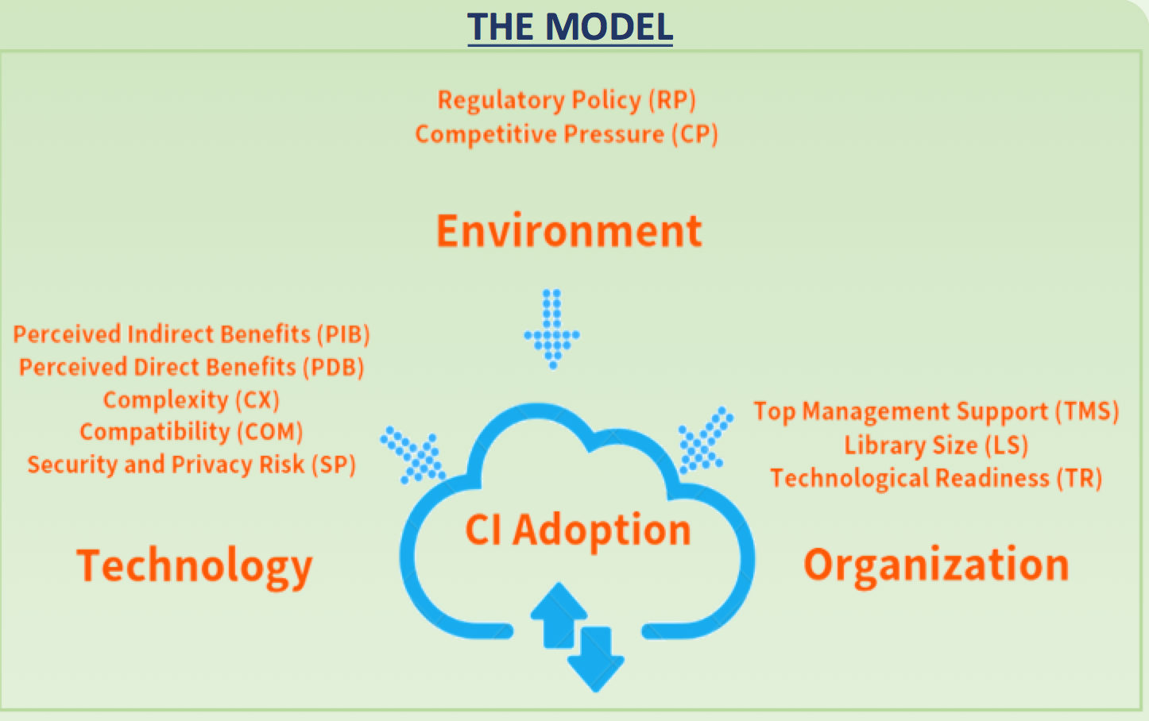

Slide 13
Smart and Connected Health Projects: Characteristics and Research Challenges
A paper accepted by the 6th International Conference on Smart Health. An extended one were accepted by Data and Information Management

Slide 14
Text/Document Analysis: a Framework
Problem Statement, Purpose of Study, and Research Questions
Term Frequency
Low-level NLP
Data Collection or Acquisition
Topic Analysis
Word Cloud
Big Data
Information Retrieval
Descriptive/Bibliometric Analysis
Content Analysis
Manageable Text Data
Answers to Research Questions

Slide 15
Maybe Irrelevant Summary
We need to develop key capabilities in order to successfully conduct the projects
Research methodology
Data integration, analysis, and access
English reporting and writing
Collaboration is crucial with committed, hard-working people
Time, effort, and true love to research

Slide 16
Now is Your Turn!
What are your research topics?
Why do you want to work on these topics?
What will be learned/impacted if your topics are explored?

