Slide 1
The Journey of
“Dynamic capabilities of a smart city: An innovative approach to discovering urban problems and solutions”
Miyoung Chong and Abdulrahman Habib
University of North Texas
College of Information
September 21, 2018

Slide 2
Agenda
Journal
Authors
Government Information Quarterly
Timeline
Our study
Introduction
Literature Review
The Purpose of the Study/ Research Questions
The city of Denton
Data Collection
Methods
Findings

Slide 3
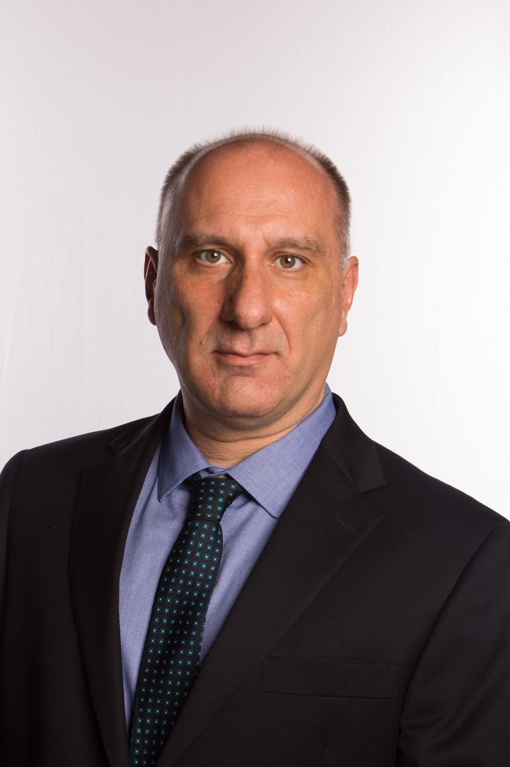

Authors
Dr. Nicholas Evangelopoulos is a Professor of Decision Sciences and Business Analytics at the University of North Texas. His research interests include statistics and text mining. His publications include articles appearing in MIS Quarterly, Communications of the ACM, Decision Sciences, and many others.
Program of Digital Convergence Business, and Director of Cyber Emotions Research Institute at YeungNam University, South Korea. He was a pioneer in network science of open and big data in the early 2000s (often called Webometrics) when he used to work for Royal Netherlands Academy and lead the World Class University project. He has published more than 100 articles in SSCI Journals. Several publications were included in top 10 list of downloads and citations. He has been co-awarded the best paper in EPI-SCImago in 2016 and included in the list of core- candidates of the Derek de Solla Price Memorial Medal in 2017.

Slide 4
Government Information Quarterly
Scopus coverage years: from 1984 to Present
Publisher: Elsevier
Subject area: Social Sciences: Sociology and Political Science: Library and Information Sciences: Law
Category Social Sciences | Rank | Percentile
Sociology and Political Science | #7/1028 | 99th
Library and Information Sciences | #2/202 | 99th
Law | #1/528 | 99th
Notes:
The media setting has transformed drastically in recent decades. Cable news channels, such as CNN, Fox News, and MSNBC, led the dramatic change by interfering with the dominance of major network news, and online media generated a democratic media environment blossoming with alternative and diverse digital media, including Politico to public media sourced on Twitter (Stocking, 2015).

Slide 5
Government Information Quarterly
CiteScore measures the average citations received per document published in this title.
YEAR | CITESCORE | CITESCORE PERCENTILE | CITATIONS | DOCUMENTS
2017 | 5.82 | 99 | 1182 | 203
2016 | 5.81 | 99 | 1109 | 191
2015 | 5.59 | 99 | 1212 | 217
2014 | 4.03 | 99 | 781 | 194
2013 | 3.90 | 99 | 706 | 181

Slide 6
Government Information Quarterly
Notes:
The media setting has transformed drastically in recent decades. Cable news channels, such as CNN, Fox News, and MSNBC, led the dramatic change by interfering with the dominance of major network news, and online media generated a democratic media environment blossoming with alternative and diverse digital media, including Politico to public media sourced on Twitter (Stocking, 2015).

Slide 7

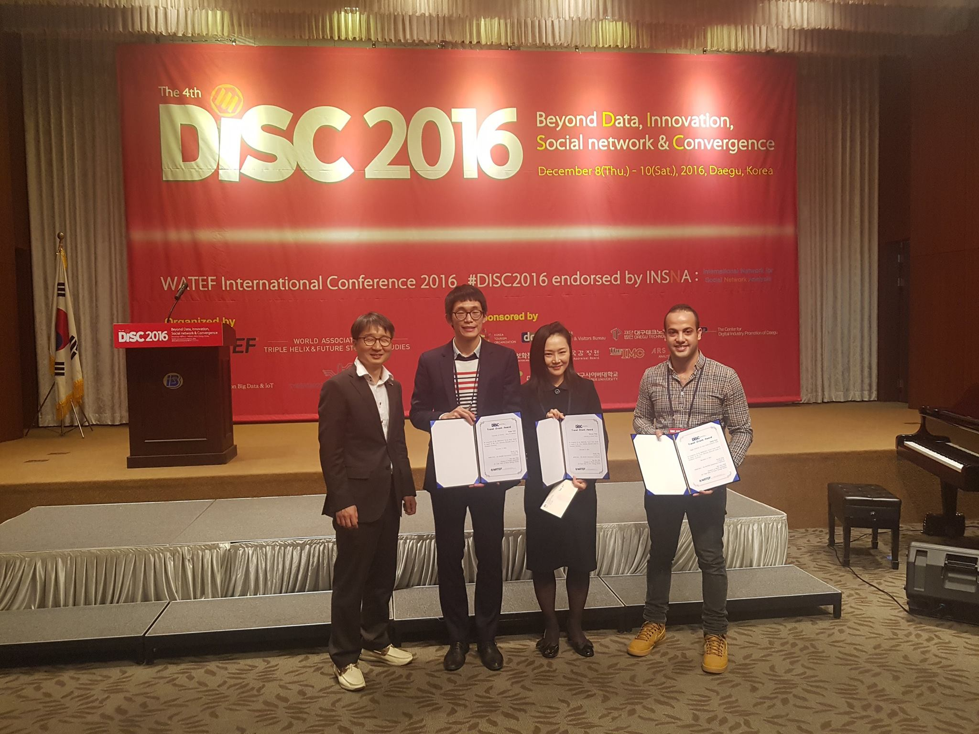
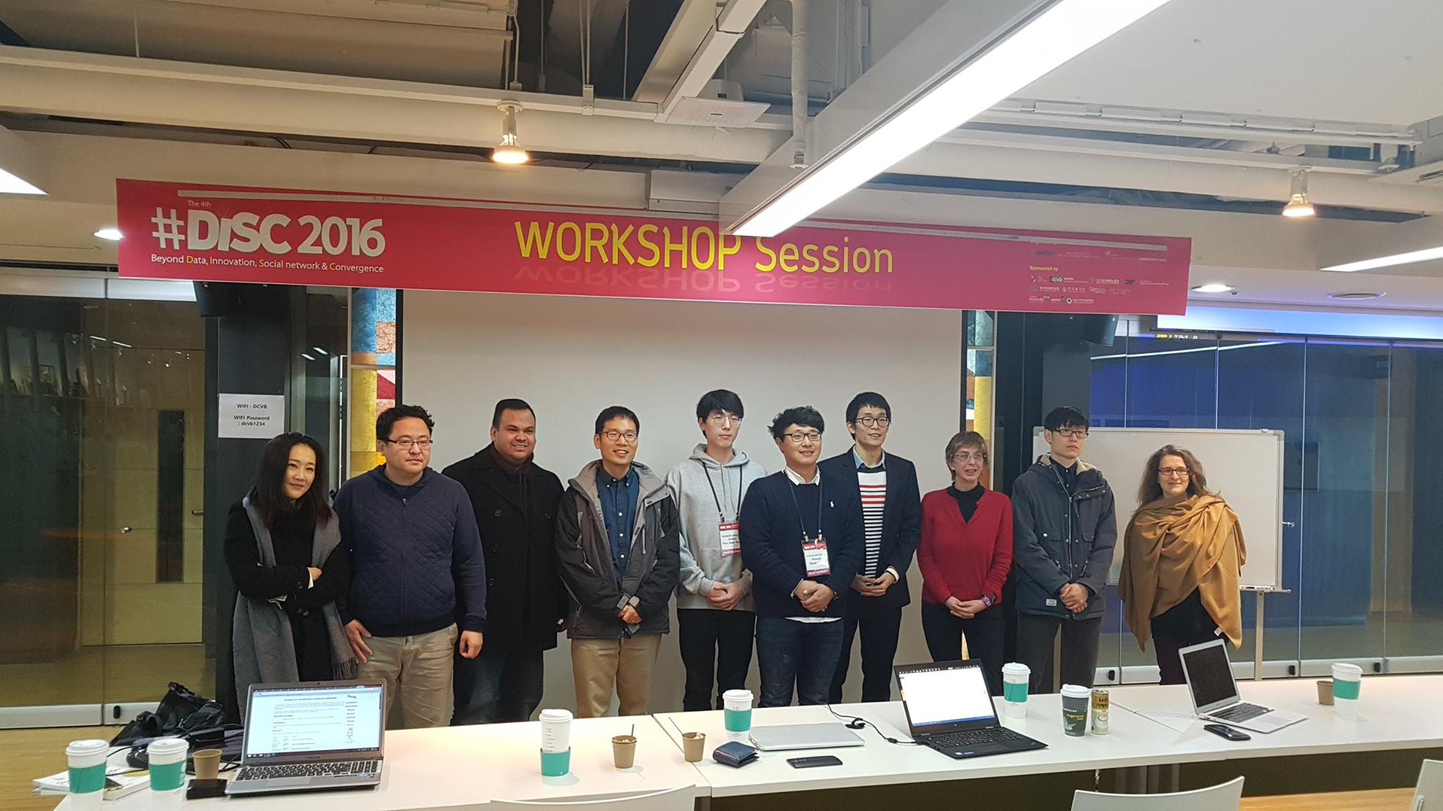
Timeline
Notes:
The media setting has transformed drastically in recent decades. Cable news channels, such as CNN, Fox News, and MSNBC, led the dramatic change by interfering with the dominance of major network news, and online media generated a democratic media environment blossoming with alternative and diverse digital media, including Politico to public media sourced on Twitter (Stocking, 2015).

Slide 8
Timeline
Title: An Innovative Approach to Discovering Urban Problems and Solutions in a Smart City
Journal: Technological Forecasting & Social Change
Submission: on March 18, 2017
From: Han Woo Park
Tue 6/20/2017, 1:50 AM
To: Chong, Mi Young
난 코멘트 자체에 접근을 못했어요.시스템이 너무 이상해요.
그리고 Q_Q에 제출하기는 너무 아까워 ㅠㅠ
그래서 GIQ editor한테 문의했음
Notes:
The media setting has transformed drastically in recent decades. Cable news channels, such as CNN, Fox News, and MSNBC, led the dramatic change by interfering with the dominance of major network news, and online media generated a democratic media environment blossoming with alternative and diverse digital media, including Politico to public media sourced on Twitter (Stocking, 2015).

Slide 9
Timeline - an email from GIQ editor
Dear Han Woo Park,
When I started reading I had the impression that the paper would fit in GIQ, however, the more I progressed the less relationship I found. For example, it seems that ‘parking issues’ are identified and that a solution is provided. The link to government information is missing here. Also the conclusions/findings are less suitable for the GIQ audience, although I like the idea of having an integrated (unified) framework as innovative approach (but this should be the focus and better articulated). A rewrite to focus on GIQ would be needed, however, it might be easier to take another route.
Best regards,
Marijn
Notes:
The media setting has transformed drastically in recent decades. Cable news channels, such as CNN, Fox News, and MSNBC, led the dramatic change by interfering with the dominance of major network news, and online media generated a democratic media environment blossoming with alternative and diverse digital media, including Politico to public media sourced on Twitter (Stocking, 2015).

Slide 10
Timeline
GIQ submission: October 31, 2017
From: Ines Mergel (Government Information Quarterly) <EviseSupport@elsevier.com>
Sent: Tuesday, March 13, 2018 6:31 PM
To: parkhanwoo@hotmail.com
Subject: Revision requested for GIQ_2017_309
Ref: GIQ_2017_309
Title: An Innovative Approach to Discovering Urban Problems and Solutions in a Smart City
Journal: Government Information Quarterly
Dear Professor PARK,
Thank you for submitting your manuscript to Government Information Quarterly. I have completed the review of your manuscript and a summary is appended below. I invite you to resubmit your manuscript after addressing all reviewer comments. The reviewers point out that your theoretical framework needs major improvements, that your data needs to be tied to the existing literature, and that the findings need to thoroughly discussed in the light of the literature in the conclusion and discussion sections.
When resubmitting your manuscript, please carefully consider all issues mentioned in the reviewers' comments, outline every change made point by point, and provide suitable rebuttals for any comments not addressed.
Notes:
The media setting has transformed drastically in recent decades. Cable news channels, such as CNN, Fox News, and MSNBC, led the dramatic change by interfering with the dominance of major network news, and online media generated a democratic media environment blossoming with alternative and diverse digital media, including Politico to public media sourced on Twitter (Stocking, 2015).

Slide 11
Timeline
Reviewer 1
Overall, the piece is very well done with literature, methods, and findings contributing greatly to the overall contribution to the literature. The topic of smart cities is still very relevant and the particular participatory aspect of this piece makes it compelling. The literature review and background are succinct and comprehensive for the length of the article.
Further, the author examines extremely relevant literature and the flow is very well done with specific aspects of the literature examined in certain subsections (ie smart cities, and citizen engagement in smart cites). The only critique of this section would be for the author to include more recent articles on smart city development (of which there are many) to enhance their knowledge of the subject and give background.
Notes:
The media setting has transformed drastically in recent decades. Cable news channels, such as CNN, Fox News, and MSNBC, led the dramatic change by interfering with the dominance of major network news, and online media generated a democratic media environment blossoming with alternative and diverse digital media, including Politico to public media sourced on Twitter (Stocking, 2015).

Slide 12
Timeline
-Reviewer 2
-The manuscript entitled “An Innovative Approach to Discovering Urban Problems and Solutions in a Smart City” is interesting and the topic is important and relevant. Here are a few comments about how to improve it.
Overall, the manuscript is interesting, but the link between some key concepts is missing or not totally clear: smart cities, data analytics, digital government, citizen engagement, etc.
In the introduction, the authors should clearly justify the importance of the phenomenon they are studying.
The manuscript will benefit from a clearer link between the broader field of digital government and the specific topic. Particularly, the authors should review and include more articles about smart cities, electronic governance, electronic local government, data analytics, and citizen engagement from specialized e-government journals such as Government Information Quarterly, the International Journal of Electronic Governance, Information Polity, and the International Journal of Electronic Government Research, among others.
Notes:
The media setting has transformed drastically in recent decades. Cable news channels, such as CNN, Fox News, and MSNBC, led the dramatic change by interfering with the dominance of major network news, and online media generated a democratic media environment blossoming with alternative and diverse digital media, including Politico to public media sourced on Twitter (Stocking, 2015).

Slide 13
Timeline
Revision extension requested and submitted on May 24, 2018
Subject: Your manuscript GIQ_2017_309_R1 has been accepted
Ref: GIQ_2017_309_R1
Title: Dynamic Capabilities of a Smart City: An Innovative Approach to Discovering Urban Problems and Solutions
Journal: Government Information Quarterly
Dear Professor PARK,
I am pleased to inform you that your paper has been accepted for publication. The reviewers have no additional comments…
Ines Mergel
Associate Editor
Government Information Quarterly
Comments from the editors and reviewers:
- Reviewer 1 - The authors have addressed the requested reviews.
- Reviewer 2 - I have not additional comments.

Slide 14
Introduction
United nation reported that by 2008 there were 3.3 billion people living in cities. This is more than fifty percent of the word population lived in urban areas.
By 2030, this figure will increase to 5 billion people. This rapid increase will over-saturate cities and increase the challenges cities face, ranging from resources to environment.
Cities generated about 80% of global GDP (2012), and this figure is increasing. Cities face many challenges with increasing populations, sustainability, climate change, and many others (Marchal, Dellink, van Vuuren, Clapp, Château, Lanzi, & van Vliet, 2012).

Slide 15
Introduction
Globally, there has been a movement toward “smart cities.” In this movement, the word “smart” implies the ability to solve problems and adapt to changes and also implies more user-friendly than just intelligent.
According to Hollands (2008), smart cities means being strategic and sustainable intelligent services. Since cities include many different aspects, smart city as a term is an interdisciplinary topic with literature from computer science, engineering, urban planning, political science, economy, and even social studies.
Notes:
Smart city is not a new term, but in the past decade, smart cities emerged worldwide as a new term applied in different context.
Many cities around the globe are labeled as “smart city,” while many others are trying to become a smart city.

Slide 16
Introduction
However, a clear and unified definition of smart city is absent in both research and industry fields. Different terminology is used to describe the smart city such as intelligent city, digital city, sustainable city, techno-city, and welling-being city (Dameri, 2013).
Wired city, digital city, and techno-city were used to indicate similar city projects and solutions although they can be simply attributed to the concept of smart city.
Dameri (2013) argues that the foremost reason for this lack of clarity is the fact that smart city is not a top-down process but a bottom-up phenomenon.
Notes:
The affinities and the divergences of the terminologies have not been clearly defined yet (Dameri, 2013).

Slide 17
Introduction
Nam and Pardo (2011) defined smart city as
an integration of infrastructures and technology-mediated services,
social learning for strengthening human infrastructure, and
governance for institutional improvement and citizen engagement.
Each dimension is very important because smart cities exist at the intersection of all of them.
ex) Functional infrastructure is critical but cannot be facilitated without engagement and collaboration of citizens.
Notes:
For example, Smart cities without ICT would be only smart communities and miss the important benefit of many available technologies that can improve efficiency and eliminate redundancies. Functional infrastructure is critical but cannot be facilitated without engagement and collaboration of citizens. These citizen collaborations along with government support foster improved policies and government and ensure fair service distribution to all citizens (Lindskog, 2004). Can you come up with a better phrase than “do things by itself”? Something a little more polished? I’m not sure what “do things mean” so more specificity would be helpful here.

Slide 18
Literature Review
Research studies have shown that the smart city system primarily focuses on integrating the three components: economic, environmental, and social. The social component may include participatory democracy, social innovation, human-scale cities, and civic participation.
Often, analysis in studies of smart cities does not sufficiently reflect the ongoing practice of how cities are actively reconstructing themselves into a smart and sustainable city.

Slide 19
The Purpose of the Study
The purpose of this study is to develop a novel methodological approach for identifying a city's problems and solutions in terms of citizens' perspectives, and present this approach as part of a broader smart city framework that focuses on dynamic capabilities.

Slide 20
Research Questions
RQ1. How can smart cities leverage citizen engagement to enhance their capability to sense opportunities for positive change in today's dynamic and challenging environment?
RQ2. How can smart cities leverage data analytics to identify solutions to their problems and enhance their capability to seize opportunities for positive change?

Slide 21
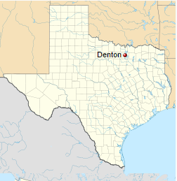
The city of Denton
Population 123,009 (2013)
the 230th largest city in the US
the 27th largest in Texas
Denton became the 7th fastest-growing city in 2011.
Figure1. the location of city of Denton

Slide 22
The city of Denton
The city initiated the City of Denton's Sustainability Plan in February of 2012. The plan includes 30 strategies across eight focus areas selected through a rigorous public involvement and prioritization process.
Strategies include recommendations for policies, community programs, outreach and education, and capital improvements. The city tracks progress on strategies with its award-winning tracking tool, D-Smart. The city has been reporting progress and Annual Reports through the city’s website.
www.cityofdenton.com/departments-services/sustainable-denton

Slide 23
Data Collection
A survey was conducted in May 2015. The survey was open to the public, but the responders of the survey were all Denton residents who are likely interested in technology because the survey was promoted through Techmill and the survey questions were posted on the Techmill’s website (https://techmill.co).
The posted survey questions are as the following:
What problems would you like to see solved in Denton?
What ideas do you have to help solve the problem?
Notes:
The study asked these open-ended questions to the residents of Denton, and they were allowed to provide answers as long as they want. The original data were gathered from 58 survey responders. After removing redundancies and unrelated responses from the collected data, the responders became 46 people. The responses of each question were reorganized with one idea per row in Excel sheets, which ended up 63 perceived problems and 59 proposed solutions prepared for the analysis.

Slide 24
Dynamic capabilities of a smart city and related actors, processes, and technologies

Slide 25
Methods
The study implemented the methodological triangulation because it facilitates uncovering conflicts or hidden themes in the data (Jick, 1979). The adopted methods that construct the triangulation are topic modeling, topic extraction, and textual analysis.
Triangulation
topic modeling
textual analysis
topic extraction
Figure 2. methodological triangulation

Slide 26
Findings
In the beginning of the analysis, to enhance the reliability of the data analysis, the two principal researchers respectively conducted qualitative text analysis to determine the five dominant themes from the problems and solutions data.
Researcher one | Research two
parking issues | parking problems
communications within the city | issues about municipal government
homeless and poverty issues | Square and downtown issues
streets situations and public transportation | city streets and roads issues
pedestrian and cyclist roads issues | pedestrians issues
Table 1. The identified key problems by the two researchers

Slide 27
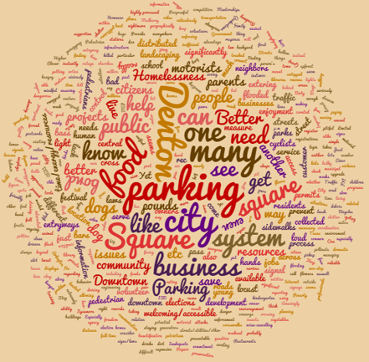
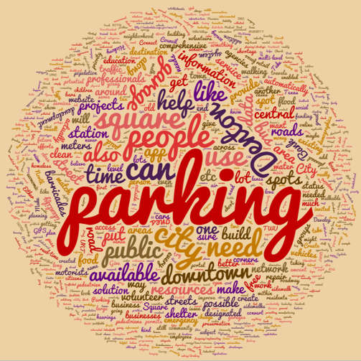
Figure 3. the word cloud of the problem data
Figure 4. the word cloud of the solution data

Slide 28
Table 2 . Comparison topics between problems and solutions through topic modeling
Themes | the identified key problems |  | Themes | the identified suggested solutions
 | Importance | Words |  | Importance | Words
parking in Square city system | 10.47 | square city parking system issues prevent owners resources business serve | Parking garage, parking spots | 15.44 | parking square city people denton time garage downtown spots central
business in the city, parking in Square | 9.11 | city projects business signs food people square parking downtown danger | city online | 3.54 | city bus preservation online building give topic pointless travel real
Save energy | 5.35 | energy pounds bad cross save flooding recent dirty week neighbors | citizens education | 3.12 | citizens put education area end send vehicles barricades motorists unsafe
Public system, resources, business in square | 5.33 | denton square resources public locust dogs customer bond business system | facilitate workshops, track record with software | 3.10 | bus repair barricades wear workshops software track defined facilitate ban
Parking, motorists and cyclists | 4.00 | parking cyclists save motorists enforcement arlington attacks records control interested | public projects, existing road | 2.84 | short projects road services community public serve existing intersection lights

Slide 29
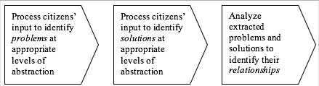
Table 1. Three broad problem categories
P# | Label | Document count
P3.1 | Issues about the Square | 13
P3.2 | Parking issues | 19
P3.3 | Public & community issues | 32
S# | Label | Document count
S3.1 | A parking garage & other improvements on the Square | 19
S3.2 | Solutions that involve the City Council and technology | 27
S3.3 | Street repairs and improvements | 16
Table 3. Three broad problem categories
Table 4. Three broad solution categories
Figure 5. A framework for the proposed problems & solutions approach

Slide 30
Table 1. Three broad problem categories
Table 5. Cross-tabulation of problems and solutions (detailed topic level) |  | Solution
 |  | A parking garage in the square | Convert a lot into parking space | Bring business | Inform the public about projects | Give locals a free pass | Help people through education | Traffic laws
Problem |  | S16.1 | S16.2 | S16.5 | S16.8 | S16.10 | S16.11 | S16.16
Parking | P16.1 | 3 | 3 | 2 | 0 | 2 | 0 | 2
The Square | P16.2 | 2 | 1 | 0 | 0 | 0 | 0 | 1
Public amenities/ infrastructure | P16.3 | 2 | 1 | 1 | 2 | 1 | 0 | 0
Downtown parking & pedestrian | P16.4 | 1 | 2 | 0 | 0 | 0 | 0 | 1
Jobs | P16.5 | 0 | 0 | 2 | 0 | 0 | 0 | 0
Homelessness | P16.7 | 0 | 0 | 0 | 0 | 0 | 2 | 1
Traffic, traffic lights | P16.11 | 1 | 0 | 0 | 0 | 1 | 0 | 2

Slide 31
Table 1. Three broad problem categories
Figure 6. Correspondence map of problems and solutions (broad abstraction level)

Slide 32
References
Clower, T. L., & Weinstein, B. L. (2008). A Look at the Economic and Demographic Projections for the City of Denton.
Dameri, R. P. (2013). Searching for Smart City definition: a comprehensive proposal. International Journal of Computers & Technology, 11(5), 2544-2551.
Jick, T. D. (1979). Mixing qualitative and quantitative methods: Triangulation in action. Administrative science quarterly, 24(4), 602-611.
Marchal, V., Dellink, R., van Vuuren, D., Clapp, C., Château, J., Lanzi, E., & van Vliet, J. (2012). OECD environmental outlook to 2050: the consequences of inaction.
Nam, T., & Pardo, T. A. (2011, June). Conceptualizing smart city with dimensions of technology, people, and institutions. In Proceedings of the 12th Annual International Digital Government Research Conference: Digital Government Innovation in Challenging Times (pp. 282-291). ACM.

Slide 33
Thank You
Questions?

