Slide 1
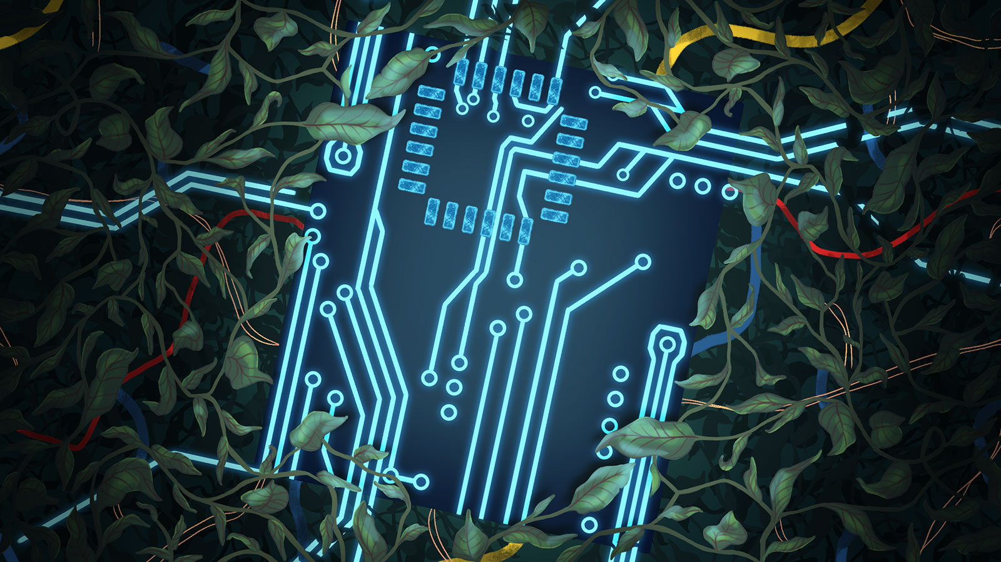
Call for Collaboration:
Catapulting the Data of Today
into the Environment of Tomorrow
Call for Collaboration: Catapulting the Data of Today into the Environment of Tomorrow Glenn McLain / February 15, 2019

Slide 2
Glenn McLain City of Denton Parks & Recreation Department Parks Landscape Architect
#1 Health, Safety & Welfare
Collect
Information
Organize
Information
Analyze
Information
Create
Ideas / concepts
From Information
Distribute
Information in the form of:
Print
Digital
Built Interactive Environments
Potential Similarities in our Process
Call for Collaboration: Catapulting the Data of Today into the Environment of Tomorrow Glenn McLain / February 15, 2019

Slide 3
Collect
Information
Organize
Information
Analyze
Information
Create
Ideas / concepts
From Information
Distribute
Information in the form of:
Print
Digital
Built Interactive Environments
Collect
Information
Through
Post - Observational Studies & Feedback
Potential Similarities in our Process ……..continued
Call for Collaboration: Catapulting the Data of Today into the Environment of Tomorrow Glenn McLain / February 15, 2019

Slide 4
Collect
Information
Organize
Information
Analyze
Information
Create
Ideas / concepts
From Information
Distribute
Information in the form of:
Print
Digital
Built Interactive Environments
Collect
Information
Through
Post - Observational Studies & Feedback
The Main Difference in our Processes…
Call for Collaboration: Catapulting the Data of Today into the Environment of Tomorrow Glenn McLain / February 15, 2019

Slide 5
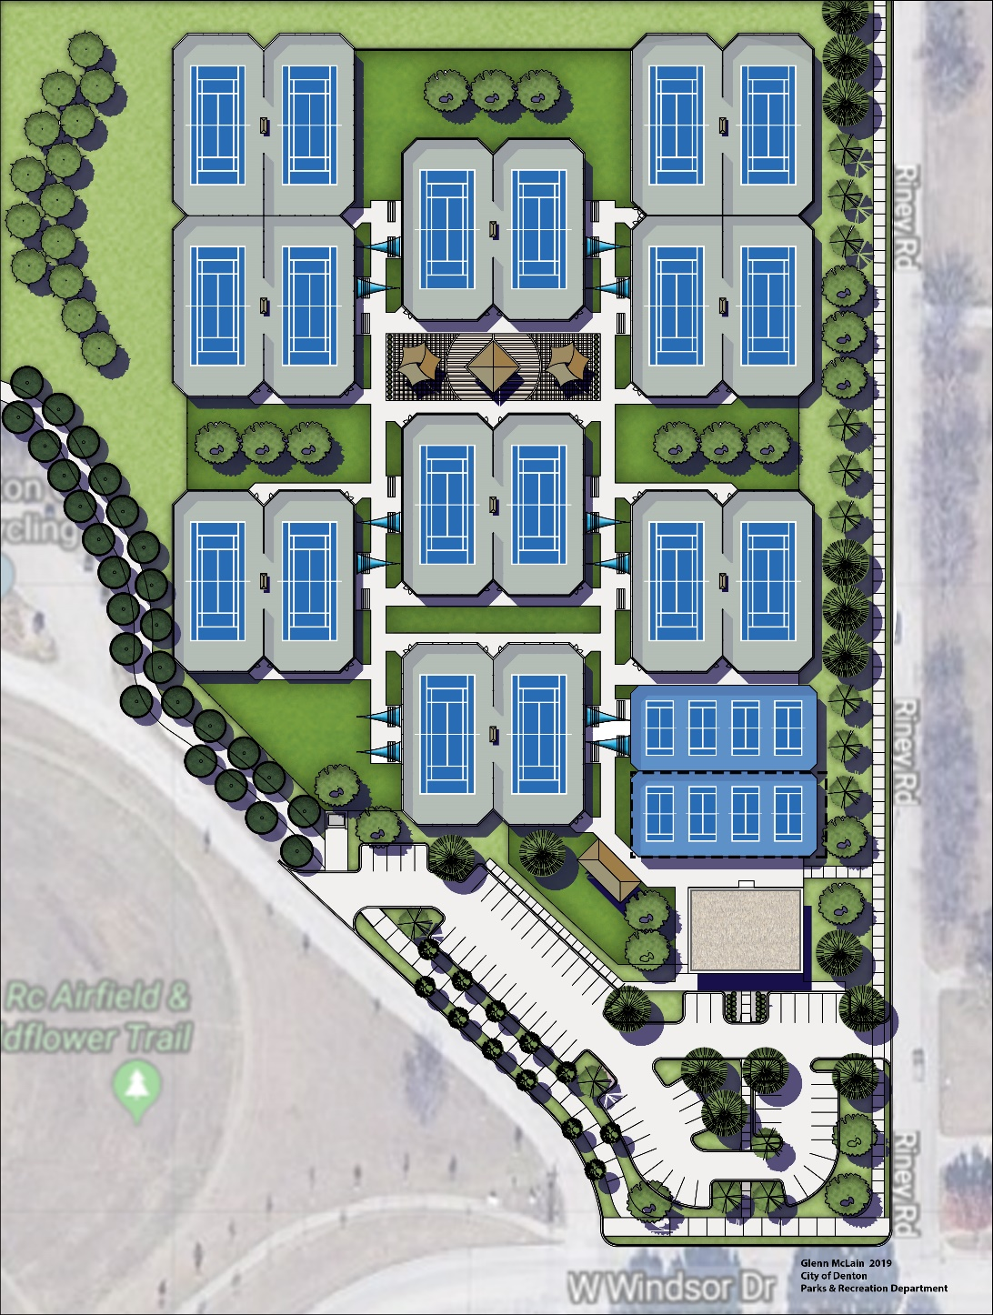
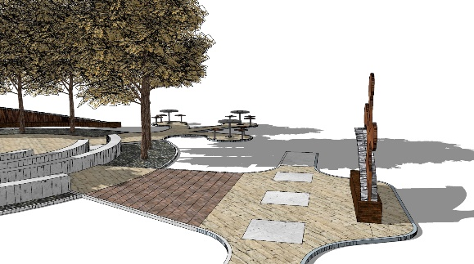
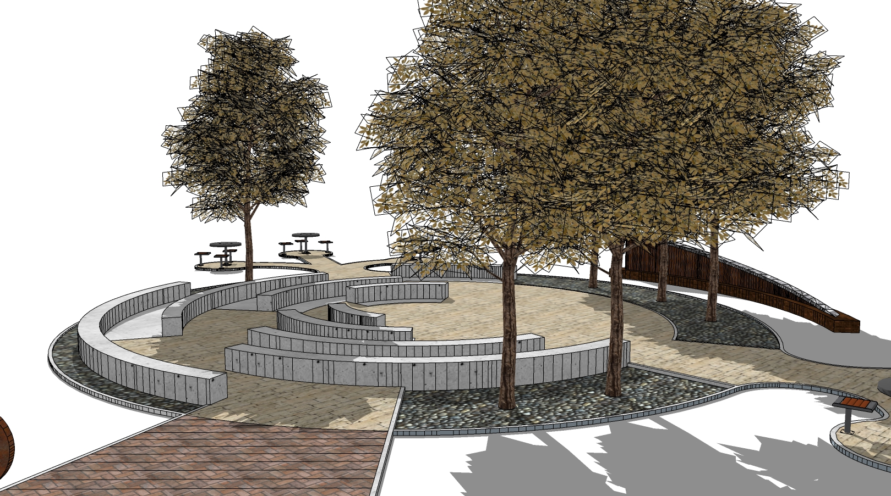
Examples:
How information, correctly handled, becomes physical, interactive environmental entities.
Glenn McLain 2019
City of Denton Parks & Recreation
Conceptual Design
Call for Collaboration: Catapulting the Data of Today into the Environment of Tomorrow Glenn McLain / February 15, 2019

Slide 6
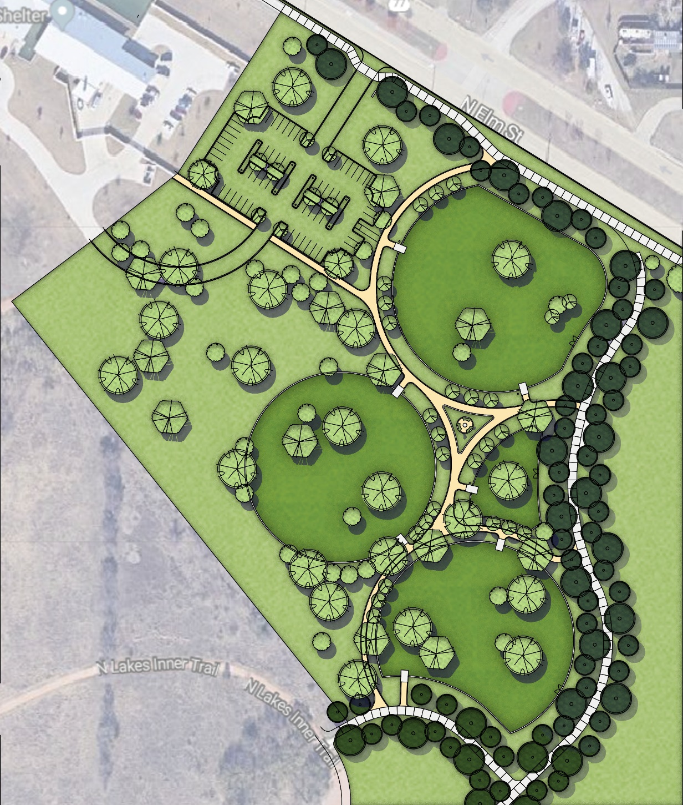
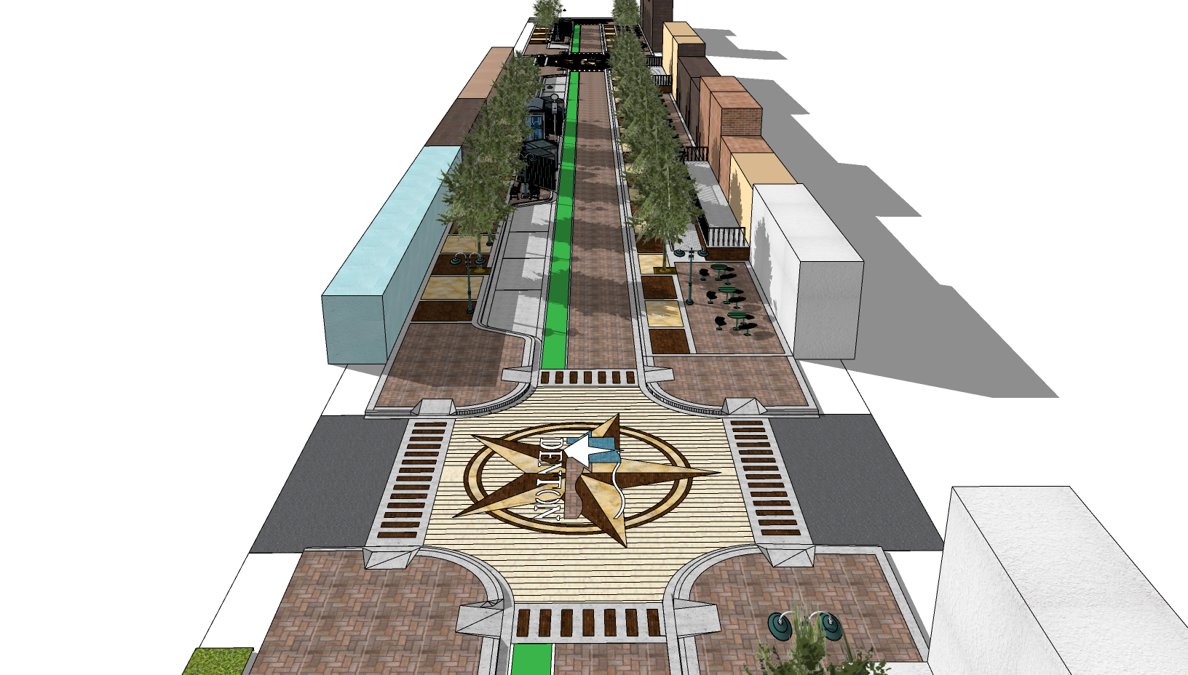
I take an interdisciplinary approach to all designs by pulling information from Aesthetics, Anthropology, Architecture, Behavioral Science, Biology, Environmental Science, Geography, Interior Design, Philosophy, Physiology, Psychology and many others…. Ultimately I think the discipline of Information Science has the potential to contribute more than all the others combined.
Call for Collaboration: Catapulting the Data of Today into the Environment of Tomorrow Glenn McLain / February 15, 2019

Slide 7
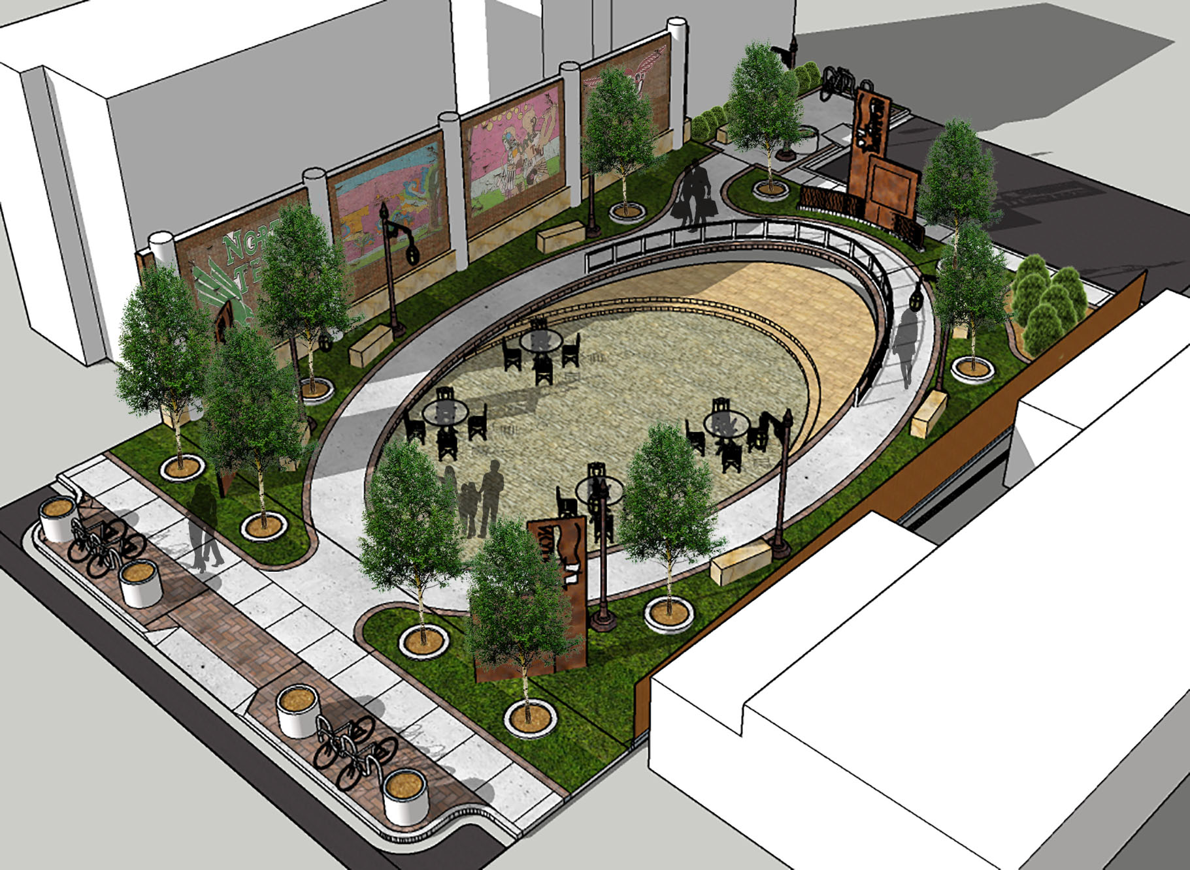
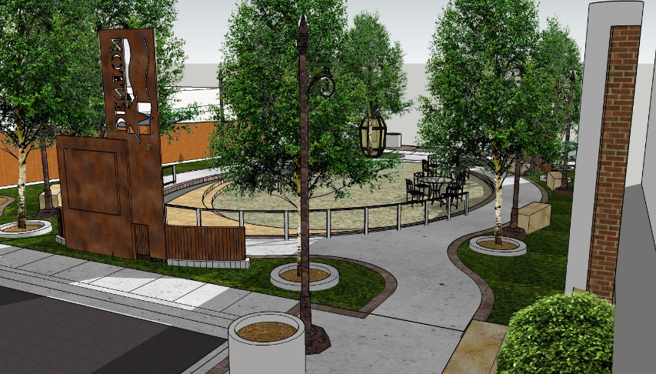
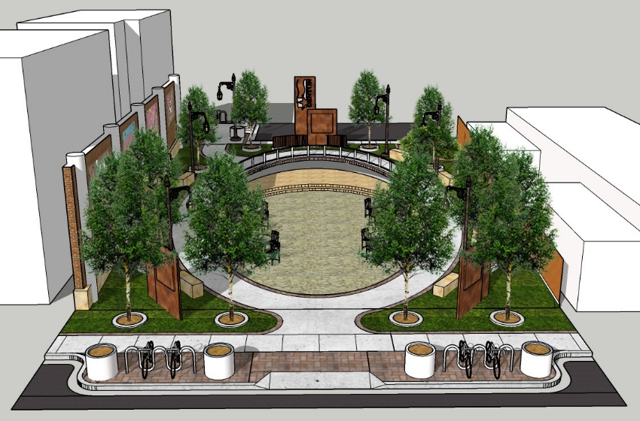
This is what happens when you lean heavily on demographics, the concept of perception & anthropology.
Call for Collaboration: Catapulting the Data of Today into the Environment of Tomorrow Glenn McLain / February 15, 2019

Slide 8
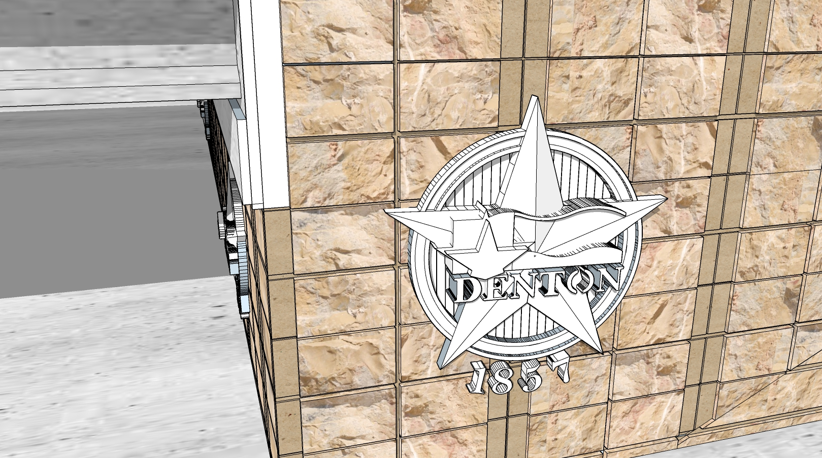
This is how information enhances the Identity of The City of Denton.
Call for Collaboration: Catapulting the Data of Today into the Environment of Tomorrow Glenn McLain / February 15, 2019

Slide 9
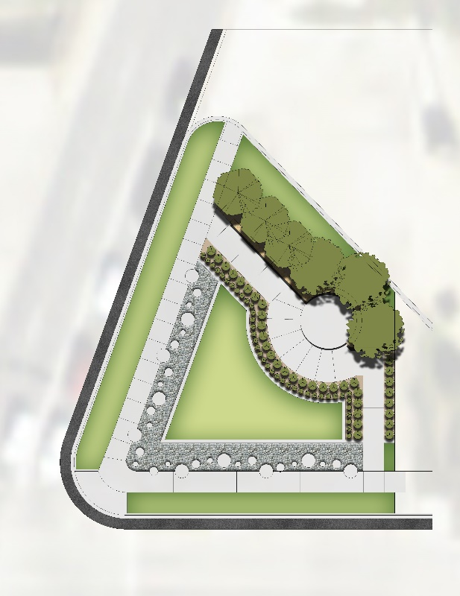
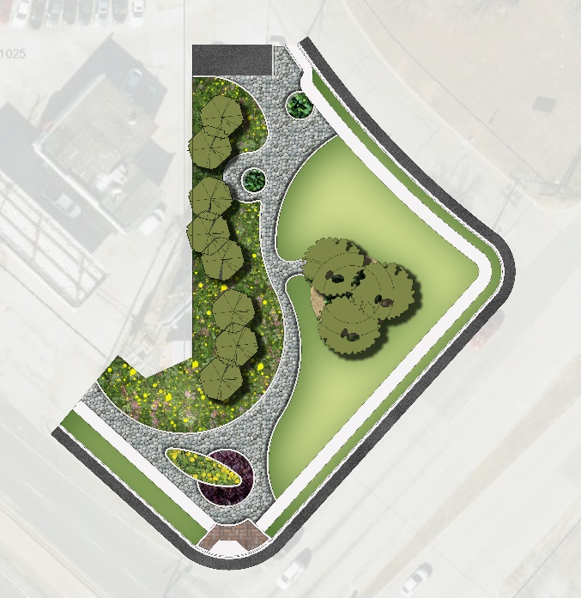
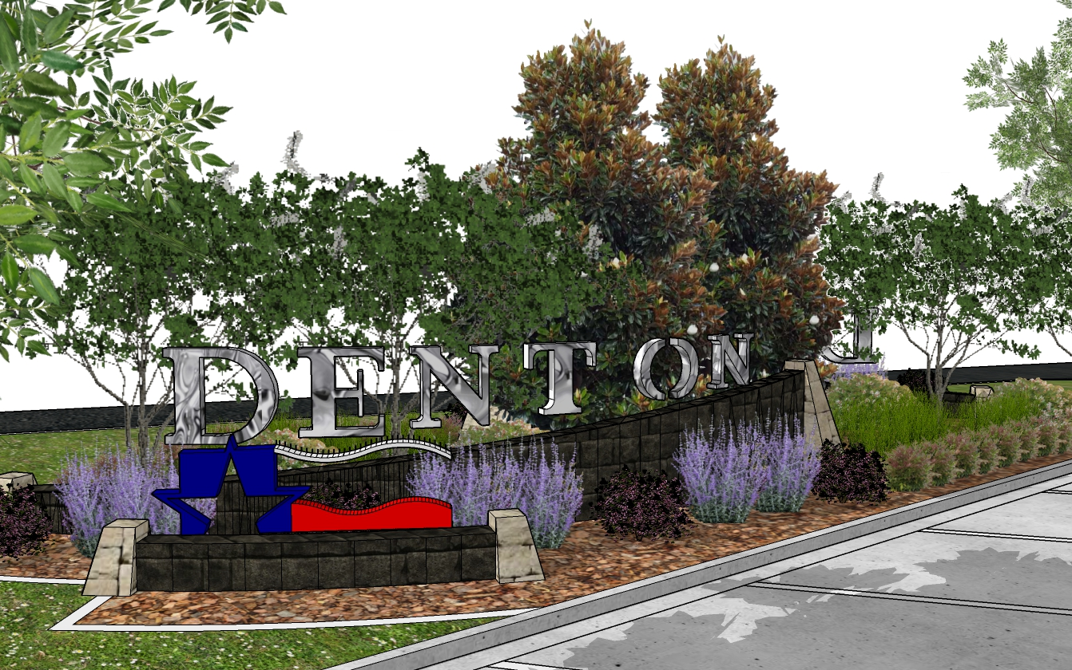
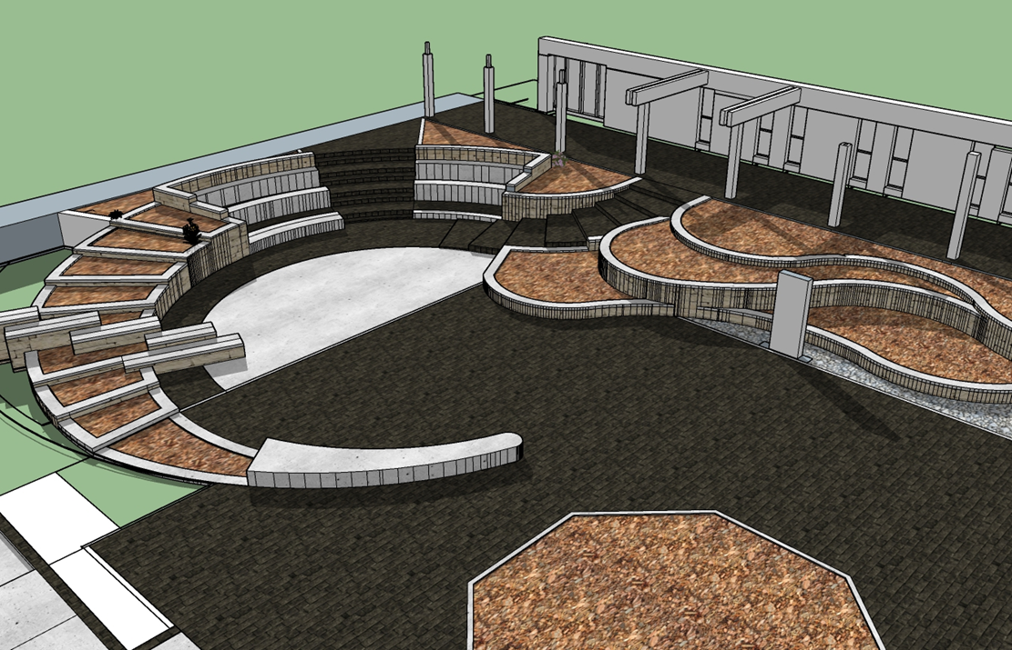
These are examples of how information helps to identify areas that need to be addressed in relation to beautification and/or the creation of subcategories of identity such as district identities, hierarchy of important spaces etc.
Call for Collaboration: Catapulting the Data of Today into the Environment of Tomorrow Glenn McLain / February 15, 2019

Slide 10
Denton Parks, Recreation & Trails 2020 Master Plan
How Information Science
Can Enhance This Process
Call for Collaboration: Catapulting the Data of Today into the Environment of Tomorrow Glenn McLain / February 15, 2019

Slide 11
What is a Master Plan?
A master plan is the ending result of a planning process which creates a complex, comprehensive framework and simplifies it in a manner that promotes orderly and consistent planning, acquisition, development, maintenance and management of the parks and recreation resources, programs and facilities.
Call for Collaboration: Catapulting the Data of Today into the Environment of Tomorrow Glenn McLain / February 15, 2019

Slide 12
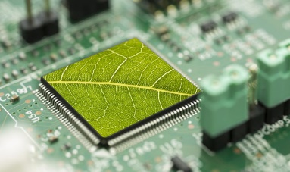
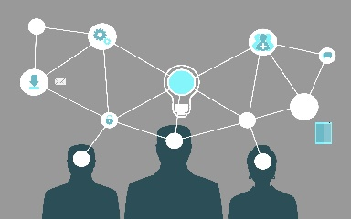
How Is It Broken Down?
4. recommendations
5. approval
6. implementation
1. data collection
2. collaboration
3. needs assessment
& identification
Call for Collaboration: Catapulting the Data of Today into the Environment of Tomorrow Glenn McLain / February 15, 2019

Slide 13
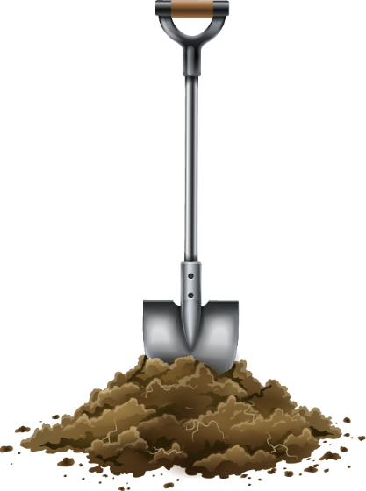
What can I collaborate on?
You can dig into:
Phases 1, 2 & 3
As well as various appendices
Call for Collaboration: Catapulting the Data of Today into the Environment of Tomorrow Glenn McLain / February 15, 2019

Slide 14
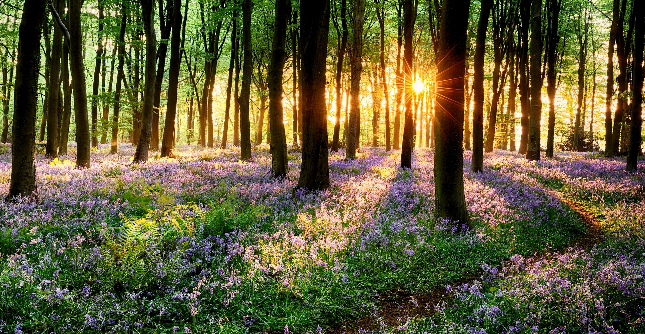
Data Collection & Collaboration
What do we have?
What do people want?
What do the experts say?
Call for Collaboration: Catapulting the Data of Today into the Environment of Tomorrow Glenn McLain / February 15, 2019

Slide 15
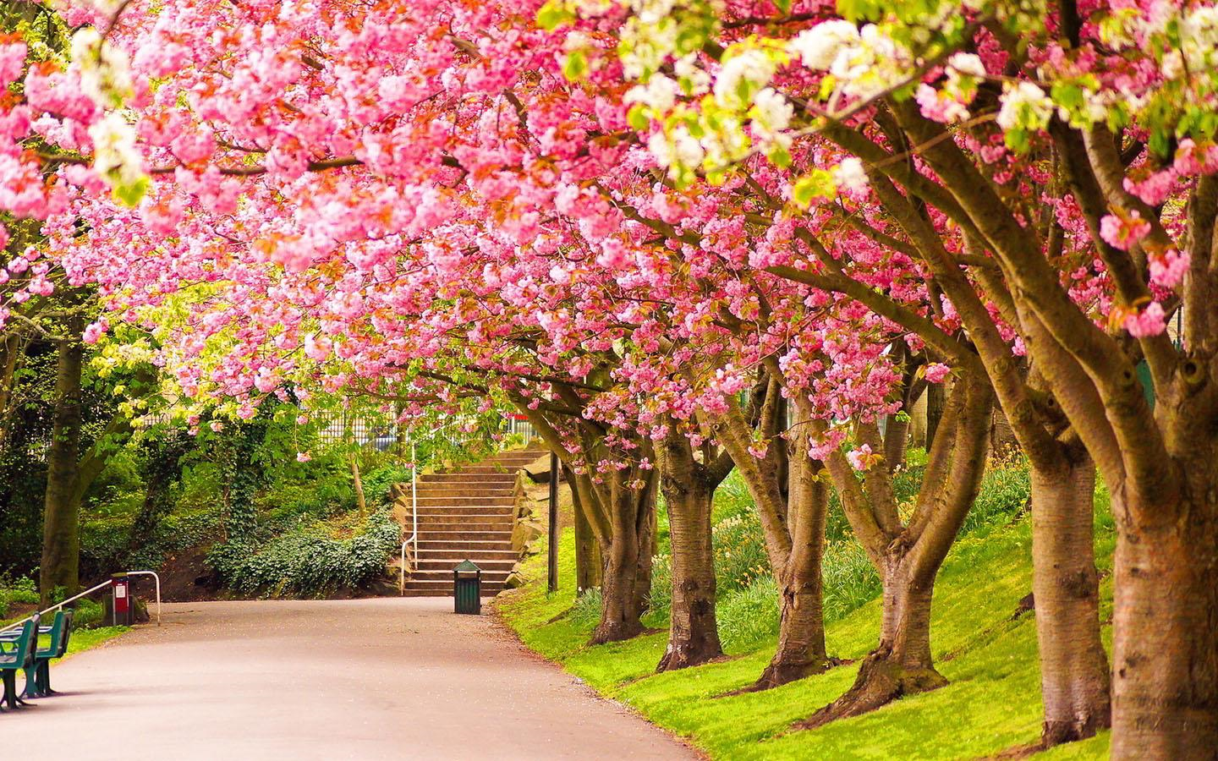
Needs Assessment & identification
What are the standards? What is feasible?
What does it take to accomplish? When?
What do we need? Where?
What are the priorities?
Call for Collaboration: Catapulting the Data of Today into the Environment of Tomorrow Glenn McLain / February 15, 2019

Slide 16
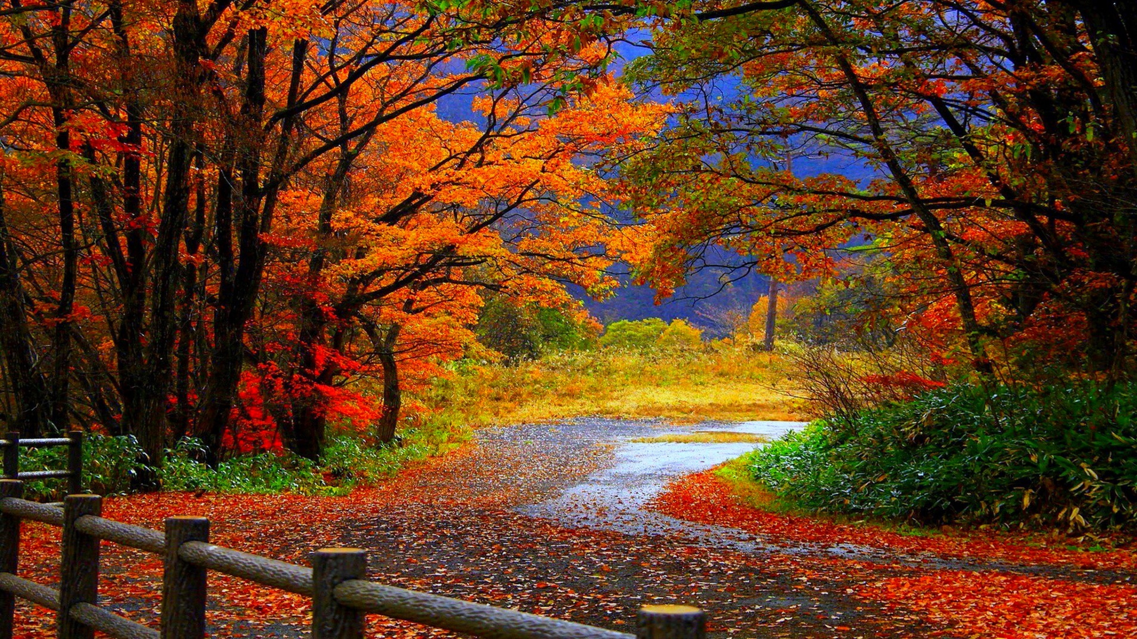
Appendix
Will set standards and guidelines?
Will assist decision makers in making informed decisions.
Will ensure quality is implemented and maintained.
Will reduce the number and frequency of decisions that need to be made regarding the Denton Park System.
Most Importantly, it will outline what the residents of the City of Denton want / need in their Park System.
Call for Collaboration: Catapulting the Data of Today into the Environment of Tomorrow Glenn McLain / February 15, 2019

Slide 17
How will you benefit?
major contribution to society
full/shared credit for any work you contribute
(online and printed version)
you are free to publish your own papers on your research
may be opportunities to co-write papers / white papers
your research will have an effect on how we design future projects
( you will be able to say that you helped design future projects through the work you do on this master plan )
There are many categories and subcategories to work on. You will have the opportunity to add many projects to your CV if you choose to do so.
Call for Collaboration: Catapulting the Data of Today into the Environment of Tomorrow Glenn McLain / February 15, 2019

Slide 18
Collaboration / Research Topics
See Handout.
Call for Collaboration: Catapulting the Data of Today into the Environment of Tomorrow Glenn McLain / February 15, 2019

